Slide 1
Office of Rural Health and Primary Care (ORHPC)
Rural Health Day November 2023

Slide 2
Missouri Organizational Chart
Notes:
The Missouri Oﬃce of Rural Health and Primary Care (ORHPC), located within the Missouri Department of Health and Senior Services (DHSS), Division of Community and Public Health (DCPH), includes the Oﬃce of Rural Health (ORH) and the Primary Care Oﬃce (PCO). This organizational structure enables a unique environment in which to engage in close collaboration enhancing equitable health care services to rural and underserved populations and communities.

Slide 3
DHSS Vision and Mission
Missouri Department of Health and Senior Services
Vision | Optimal health and safety for all Missourians, in all communities, for life.
Mission | To promote health and safety through prevention, collaboration, education, innovation, and response.
Notes:
The DHSS serves the citizens of Missouri by working to improve the health and quality of life for Missourians of all ages. The DCPH is responsible for supporting and operating more than 100 programs and initiatives addressing public health topics, such as communicable disease control, chronic disease management, health promotion, genetic health conditions, maternal and child health, vital statistics, and health care access. The division also assures the continuity of essential public health services to all citizens of and visitors to the state of Missouri.

Slide 4
Staff Representing ORHPC
Valerie Howard ORHPC Chief
Administrative Office Assistant
Shirley Murphy Rural Health Manager (MORH) |  | Aleesha Jones Primary Care Manager (PCO)
Diana Winder Rural Health Coordinator | Deetrilynn Galbreath Workforce Development Manager |  | Erin Davis Workforce Development Manager
Nathan James Rural Health Coordinator | Ashlee Griffin Primary Care Coordinator |  | Christen Easter Primary Care Coordinator

Slide 5
ORHPC Programs and Grants
Missouri Office of Rural Health (MORH) | Missouri Primary Care Office (PCO) | PCO: Missouri Health Professional Student and Loan Repayment Programs
State Office of Rural Health (SORH) Grant | Primary Care Office (PCO) Grant | Missouri Student Loan Repayment Program (SLRP) Grant
Small Rural Hospital Improvement Program (SHIP) Grant | J-1 Visa/State 30 Waiver Program | Health Professional Loan Repayment Program
Medicare Rural Hospital Flexibility (Flex) Grant Program | National Interest Waiver (NIW) Program | Rural Primary Care Physician Grant Program
One-Time Grants (3): HRSA: SHIP COVID Grant COVID SHIP Testing/Mitigation CDC: Health Disparities | One-Time Grants (2): CDC: ELC Grant CDC: ELC-ED Grant | Graduate Medical Residency Grant
Contracts: 154 | Community-Based Faculty Preceptor Tax Credit Program | Contracts: 341

Slide 6
Missouri State Office of Rural Health
Acting as a central hub for the collection and dissemination of information related to rural health care, including research findings related to rural health;
Monitoring, coordinating, and facilitating rural health efforts with a focus on avoiding duplication and inefficiencies;
Providing technical assistance (TA) and educational opportunities to rural health stakeholders to support and improve efforts on quality, operational, and financial outcomes;
Promoting and developing diverse and innovative health care service models;
Recommending appropriate public policies to ensure the viability of rural health care delivery; and
Biennially reporting activities and recommendations to the governor and members of the general assembly, to include an overview of health data and issues in rural Missouri.
Notes:
Needs vary among Individuals and communities

Slide 7
Missouri State Office of Rural Health
Small Rural Hospital Improvement Plan
Medicare Rural Hospital Flexibility Grant
State Office of Rural Health
7
Notes:
The MORH manages three federally funded grants with multiple programs within each grant, specifically designed to strengthen the viability of rural health care providers, hospitals, and clinics, while improving their quality of care. The list below includes the federally awarded grants providing pass-through funding or services for hospitals and clinics.

Slide 8
Small Rural Hospital Improvement Program (SHIP)
Notes:
The SHIP grant provides funding for small rural hospitals to implement quality and operational improvement efforts to meet their organization’s value-based payment care goals. SHIP also assists eligible hospitals to participate in delivery system reforms such as becoming or joining a Medicare Shared Saving Program or Accountable Care Organization (ACO), or other shared saving programs. Further, SHIP allows participating hospitals to utilize these funds to purchase hardware, software, and telemedicine equipment to assist in meeting data system requirements established under the Medicare Program.

Slide 9
Medicare Rural Hospital Flexibility Program (Flex)
Glory Dhanaraj
Mankin Consulting
MRHA Connect
MPCA – MHPPS
Notes:
The FLEX grant provides support to critical access hospitals (CAHs) emphasizing continuous quality improvement, quality reporting, performance improvement, and benchmarking to improve patient care, financial practices, and hospital operations. Flex also assists facilities with establishing or expanding the provision of rural emergency medical services.
Flex focuses on:
Increasing the number of CAHs consistently reporting quality data.
Improving the quality of care in CAHs.
Maintaining and improving the financial viability of CAHs.
Building the capacity of CAHs to achieve measurable improvements in the health outcomes of rural communities.

Slide 10
Successes
Success in rural health not per slides and not per program maybe just a slide of successes because it is just 15 mins.
Accomplishments and outcomes for the past year
What we are proud of and what we have done
We are celebrating!
Notes:
The FLEX grant provides support to critical access hospitals (CAHs) emphasizing continuous quality improvement, quality reporting, performance improvement, and benchmarking to improve patient care, financial practices, and hospital operations. Flex also assists facilities with establishing or expanding the provision of rural emergency medical services.
Flex focuses on:
Increasing the number of CAHs consistently reporting quality data.
Improving the quality of care in CAHs.
Maintaining and improving the financial viability of CAHs.
Building the capacity of CAHs to achieve measurable improvements in the health outcomes of rural communities.

Slide 11
Medicare Rural Hospital Flexibility Program (Flex)
Glory Dhanaraj
Mankin Consulting
MRHA Connect
MPCA – MHPPS
Notes:
The FLEX grant provides support to critical access hospitals (CAHs) emphasizing continuous quality improvement, quality reporting, performance improvement, and benchmarking to improve patient care, financial practices, and hospital operations. Flex also assists facilities with establishing or expanding the provision of rural emergency medical services.
Flex focuses on:
Increasing the number of CAHs consistently reporting quality data.
Improving the quality of care in CAHs.
Maintaining and improving the financial viability of CAHs.
Building the capacity of CAHs to achieve measurable improvements in the health outcomes of rural communities.

Slide 12
Medicare Rural Hospital Flexibility Program (Flex)
Glory Dhanaraj
Mankin Consulting
MRHA Connect
MPCA – MHPPS
Notes:
The FLEX grant provides support to critical access hospitals (CAHs) emphasizing continuous quality improvement, quality reporting, performance improvement, and benchmarking to improve patient care, financial practices, and hospital operations. Flex also assists facilities with establishing or expanding the provision of rural emergency medical services.
Flex focuses on:
Increasing the number of CAHs consistently reporting quality data.
Improving the quality of care in CAHs.
Maintaining and improving the financial viability of CAHs.
Building the capacity of CAHs to achieve measurable improvements in the health outcomes of rural communities.

Slide 13
Medicare Rural Hospital Flexibility Program (Flex)
Glory Dhanaraj
Mankin Consulting
MRHA Connect
MPCA – MHPPS
Notes:
The FLEX grant provides support to critical access hospitals (CAHs) emphasizing continuous quality improvement, quality reporting, performance improvement, and benchmarking to improve patient care, financial practices, and hospital operations. Flex also assists facilities with establishing or expanding the provision of rural emergency medical services.
Flex focuses on:
Increasing the number of CAHs consistently reporting quality data.
Improving the quality of care in CAHs.
Maintaining and improving the financial viability of CAHs.
Building the capacity of CAHs to achieve measurable improvements in the health outcomes of rural communities.

Slide 14
State Office of Rural Health (SORH)
MIH Kick Off
Biennial Report
NRHA Rural CEO Training
Letters Of Support
Notes:
The SORH grant supports the creation of an institutional framework to link small rural communities with state and federal resources to develop long-term solutions to support rural health problems. The grant requires a $3 state to $1 federal match. The SORH grant has three primary areas of focus:
Dissemination of Missouri rural health information.
Coordination of Missouri-based activities related to rural health care, including providing support for grant proposals, providing resources, and facilitating connections.
Facilitation of rural recruitment and retention by providing access to a platform for job postings and recruitment and retention training sponsorships, and assist with recruitment services.

Slide 15
Missouri Primary Care Office
NEW PROGRAMS
Notes:
The PCO aims to improve access to comprehensive primary care services for rural and urban underserved populations through increasing health care workforce availability to meet the needs of the Missouri underserved populations. The PCO supports and enhances health systems to optimize effectiveness and eliminate health disparities.
Access to quality preventive and primary care services remains central to improving the health status of Missourians. The PCO efforts are vital to ensuring the state takes actions to address the availability of primary care services for Missourians. The PCO collaborates with various state and federal organizations, coordinates activities in the state related to the delivery of primary care services, and supports facilitation of the recruitment and retention of health care providers. The PCO initiatives and priorities include:
Measuring access to primary care through health care workforce and shortage designation analysis; addressing the Health Professional Shortage Areas (HPSAs) in Missouri.
Recruitment and retention efforts for a diverse workforce of medical, dental, mental, and public health care providers in underserved areas.
Managing the Conrad State 30/J-1Visa Waiver Program, National Interest Waiver Program, Missouri Graduate Medical Education Grant Program, Community-Based Faculty Preceptor Tax Credit Program, and Health Professional Student Loan and Loan Repayment programs.
Conducting a Statewide Primary Care Needs Assessment.
Collaborating and providing technical assistance to improve access to primary care services.
Collaborating with organizations and facilities to apply for HPSA designations where the need exists to improve access to health care.
Assisting those working to increase access to primary care services for all, and reduce disparities seen in our rural and urban underserved populations.

Slide 16
Missouri Office of Rural Health and Primary Care
The ORHPC’s programs focus on increasing access to quality health care, increasing the health care workforce in health care professional shortage areas, and targeting health improvements in rural and underserved areas. These programs serve and support communities, health care providers, FQHCs, rural health clinics and hospitals, and critical access hospitals (CAHs). The ORHPC also enhances access to health care services for rural and underserved populations through work with partnerships and local health advocates. The ORHPC initiatives and priorities include:
Identifying the obstacles and needs of health care providers and patients in rural and underserved areas.
Developing health initiatives designed to improve the health of people living in rural and underserved areas.
Collaborating with partners to implement strategies and create impactful outcomes.
Addressing social drivers of health (SDOH) as a primary approach to achieving health equity.
Notes:
The ORHPC’s programs focus on increasing access to quality health care, increasing the health care workforce in health care professional shortage areas, and targeting health improvements in rural and underserved areas. These programs serve and support communities, health care providers, FQHCs, rural health clinics and hospitals, and critical access hospitals (CAHs). The ORHPC also enhances access to health care services for rural and underserved populations through work with partnerships and local health advocates. The ORHPC initiatives and priorities include:
Identifying the obstacles and needs of health care providers and patients in rural and underserved areas.
Developing health initiatives designed to improve the health of people living in rural and underserved areas.
Collaborating with partners to implement strategies and create impactful outcomes.
Addressing social drivers of health (SDOH) as a primary approach to achieving health equity.

Slide 17
ORHPC Implements Rural Health Initiatives
Address the health disparities, access to care problems and deficiencies requiring innovative initiatives and collaboration and partnerships.
Maximize the use of existing resources to assist rural hospitals, clinics, and providers in strengthening their rural health care delivery systems.
Provide technical assistance, research, disseminate, and implement innovative health care delivery approaches.
Decreasing health disparities and increasing health equity.
Rural health initiatives to increase access to healthcare services.
Increase the healthcare workforce in healthcare professional shortage areas.
Targeting health improvements in rural Missouri.
Collaborate with partners to implement strategies and create impactful outcomes.
Monitor, coordinate, and facilitate rural health efforts and activities.
Develop Rural Health Initiatives designed to improve the health of people living in rural areas.
Addressing social determinants of health as a primary approach to achieving health equity.
Notes:
Needs vary among Individuals and communities

Slide 18
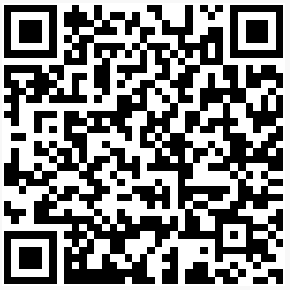
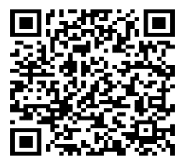
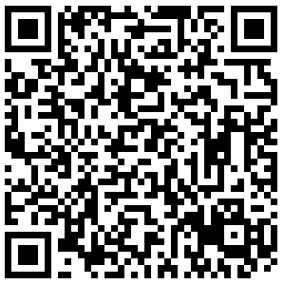
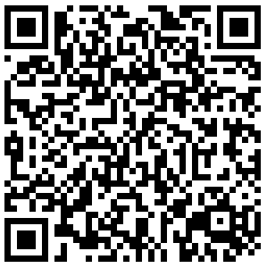
Rural Health Webpage:
RHI Center (The Blog):
Rural Health Publications:
Biennial Report published every 2 years.
Focuses on rural health factors, data and issues that impact the health of Missouri’s 2.06 million rural residents.
Demonstrates impacts on Missouri’s aging population, chronic disease, Coronavirus Disease 2019 (COVID-19), infant and child mortality, and access to care.
Recommendations to the Governor and General Assembly.
Biennial Report
Current Publication
2020-2021

Slide 19
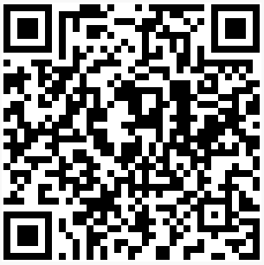
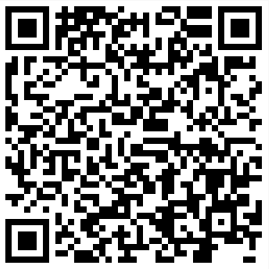
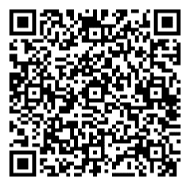
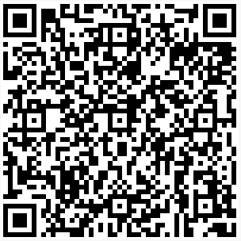
Primary Care Office and Publications
Primary Care webpage:
Publications:
Primary Care Resource Initiative For Missouri
(PRIMO) Annual Report:
Primary Care Needs Assessment (PCNA) Report:

Slide 20
Missouri Health Professional Student Loan and Loan Repayment Programs
There are 4 Programs offered through DHSS:
Designed to increase access to health care in HPSAs.
Recruitment/retention of providers in HPSAs.
Awards student and loan repayment funds to qualified students and providers.
Earn forgiveness by serving at DHSS-approved sites.
Notes:
There are four (4) Health Professional Loan and Loan Repayment Programs offered through DHSS.

Slide 21
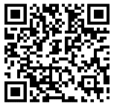
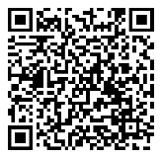
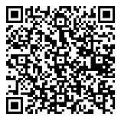
Missouri State Funding Opportunities
State funding opportunities are posted on the Missouri Buys webpage:
To apply for a State funding opportunity, follow step-by-step instructions for submitting bids:
Not limited to just DHSS opportunities.
Filter the search by bid type, commodities, and the state agency.
Additional funding opportunities posted on the DHSS Invitation for Bids or Proposals webpage:
Follow the directions associated with the funding opportunity you select.

Slide 22
Contact ORHPC
Office of Rural Health and Primary Care Missouri Department of Health and Senior Services PO Box 570 Jefferson City, MO 65102-0570
Telephone: 573-751-6441 or (toll-free) 800-891-7415 Fax: 573-522-8146
Email: ORHPCinfo@health.mo.gov DHSS.LoanRepayment@health.mo.gov
Webpages: https://health.mo.gov/living/families/ruralhealth/index.php
https://health.mo.gov/living/families/primarycare/

