Slide 1

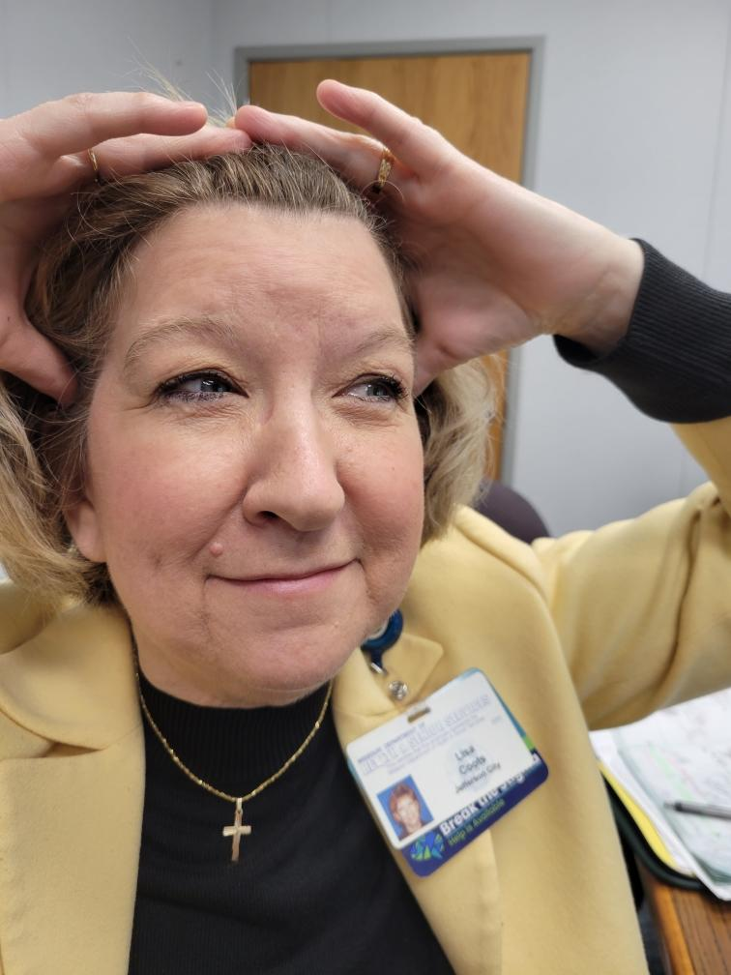

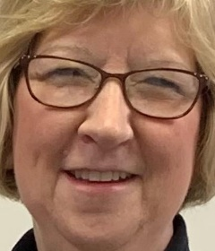


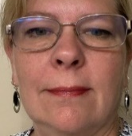
Bureau Update
Missouri Department of Health & Senior Services
Bureau of Home Care & Rehabilitative Standards
Lisa Coots, RN, Bureau Administrator

Slide 2
OBJECTIVES

Slide 3
Objectives
Review federal home health & hospice regulatory changes
Highlight Missouri’s newly proposed hospice rules
List frequently cited deficient practices for HHAs & HOs
Explain agency navigation through an immediate jeopardy citation
Describe Missouri’s 2021 home health & hospice statistics and trends
Discuss hot topics on the horizon
Update on OASIS E Training by the new OASIS Education Coordinator

Slide 4
REGULATORY UPDATES

Slide 5
Federal Regulatory Changes
COVID-19 Health Care Staff Vaccination
  Home Health (G687) 42 CFR 484.70
  Hospice (L900) 42 CFR 418.60
  On April 5, 2022, CMS sent out revisions to QSO memos

Slide 6
CMS Quality Safety & Oversight (QSO) Memos
QSO-22-07-ALL original date of December 28,2021
https://www.cms.gov/files/document/qso-22-07-all.pdf
QSO-22-09-ALL original date of January 14, 2022
  https://www.cms.gov/files/document/qso-22-09-all-injunction-lifted.pdf
QSO-22-11-ALL original date of January 20, 2022
https://www.cms.gov/files/document/qso-22-11-all-injunction-lifted.pdf
Hospice Attachment
https://www.cms.gov/files/document/attachment-c.pdf
Home Health Attachment
https://www.cms.gov/files/document/attachment-g.pdf

Slide 7
Surveying for Compliance
Surveyors will be asking for the following:
Vaccination policies and procedures
  Ensuring all 10 components of the policy are addressed
Contingency plan to mitigate the spread
List of all staff with their position/role & their vaccination status
Percentage of unvaccinated staff
Newly hired staff names in the last 60 days

Slide 8
Surveying for Compliance Cont.
Surveyors will select a sample of staff based on guidance
See Attachment 1- Home Health Surveyor Tool
See Attachment 2 – Hospice Surveyor Tool

Slide 9
Updated Code of Federal Regulations for Home Health Services
Allows Advanced practice nurses to certify/recertify and order home health services
Occupational therapist allowed to complete the initial & comprehensive assessment when ordered with another rehab service
Allows one aide supervision visit to occur within a 60 day period via a two-way audio-video telecommunication
Aide must complete retraining and competency eval for deficient skills

Slide 10
Consolidated Appropriations Act (CCA 2021) (Section 407)
Amended Title XVIII of the SSA establishing additional survey and enforcement requirements for hospice programs

Slide 11
Consolidated Appropriations Act (CCA 2021) (Section 407) Cont.
Improvement in consistency of surveys
Expanding CMS-based surveyor training to Accrediting Organizations (AOs)
AOs requirement to use Form CMS 2567 to document survey findings
Requirement of multidisciplinary survey teams
Prohibition of conflicts of interest of surveyors
Establishment of state toll-free complaint line for hospice issues
Requirement for public disclosure of survey information
Development and implementation of enforcement remedies (CMPs)

Slide 12
State Proposed Hospice Regulations
19 CSR 30-35.010 Hospice Program Operations
Relaxed definitions for dietary counselor and spiritual counselor (chaplain)
Mirrored Medicare for Social worker definition
Changed IDG meetings to every 15 days
Added emergency preparedness to match the federal regulations
Added federal regulations to infection control
Deleted the 3 hour timeframe for unscheduled non-emergent visits
Changed bereavement visit to an “encounter” (phone calls could be substituted for in person visit)

Slide 13
State Proposed Hospice Regulations Cont.
19 CSR 30-35.020 Hospice Providing Direct Care in a Hospice Facility
Last updated in 2008
Major overhaul
Updated all Life Safety Codes regulations

Slide 14
DEFICIENT PRACTICES

Slide 15
Home Health Complaint Surveys
Calendar Year - 2019
19 Complaints
6 - Substantiated
Calendar Year - 2020
Calendar Year - 2021
22 Complaints
7 - Substantiated
12 Complaints
13 - Unsubstantiated
3 - Substantiated
9 - Unsubstantiated
15 - Unsubstantiated

Slide 16
Hospice Immediate Jeopardy CoPs
418.54
Initial and Comprehensive Assessment of the Patient
418.100
Organization and Administration of Services
418.112
Hospices that Provide Hospice Care to Residents of SNF/NF or ICF/MR

Slide 17
Hospice Complaint Surveys
Calendar Year - 2020
49 Complaints
26 Substantiated
Calendar Year - 2021
Calendar Year - 2022
46 Complaints
29 Substantiated
39 Complaints
23 Unsubstantiated
25 Substantiated
14 Unsubstantiated
17 Unsubstantiated

Slide 18
Home Health Administration
First Quarter
Administrator – 9 Alt. Administrator – 8
Second Quarter
Administrator – 14 Alt. Administrator – 15
Third Quarter
Administrator – 5 Alt. Administrator - 10
Fourth Quarter
Administrator – 5 Alt. Administrator – 11

Slide 19
Hospice Administration
First Quarter
Administrator – 8 Supervising RN – 9
Second Quarter
Administrator – 10 Supervising RN – 6
Third Quarter
Administrator – 8 Supervising RN - 14
Fourth Quarter
Administrator – 9 Supervising RN – 17

Slide 20
Home Health Recertification Surveys
Calendar Year - 2019
44 Recertification
Calendar Year - 2020
Calendar Year - 2021
42 Recertification
18 Follow up Surveys
14 Recertification
2 Follow up Surveys
8 Follow up Surveys

Slide 21
Hospice Recertification Surveys
Calendar Year - 2019
21 Recertification
Calendar Year - 2020
Calendar Year - 2021
21 Recertification
7 Follow up Surveys
27 Recertification
7 Follow up Surveys
9 Follow up Surveys

Slide 22
IMMEDIATE JEOPARDY

Slide 23


Slide 25
Home Health Immediate Jeopardy CoP Cited Calendar Year 2022
484.60
Care Planning, Coordination of Services & Quality of Care
All Home Health IJs Cited this CoP

Slide 26
Immediate Jeopardy
Appendix Q in the SOM, revised July 31, 2019
Three Key Components
  Noncompliance with a regulation
  Caused or created a likelihood that serious injury, harm, impairment or death would occur or recur
  Immediate action is necessary to prevent the occurrence or recurrence of serious injury, harm, impairment or death
https://www.cms.gov/Medicare/Provider-Enrollment-and-Certification/SurveyCertificationGenInfo/Downloads/QSO19-09-ALL.pdf

Slide 27
Immediate Actions Needed by Administration/Management
Remember – the goal is to remove the systemic problem so that patients are safe
  Begin developing a “Removal Plan”
  Administration should immediately get involved by making home visit(s) to assess patient and review the clinical record, and
    Review of policies and procedures, making revisions as needed
    Educate staff with in-services
    Make supervisory visits

Slide 28
What is a “Removal Plan”?
Document the immediate action an agency will take to prevent serious harm from occurring or recurring
Identify in great detail all actions the agency will take to IMMEDIATELY address the non-compliance so patients are safe and free from harm
Address how additional serious harm will be prevented
Includes a date by which the agency asserts the likelihood for serious harm no longer exists
Must be accepted by the survey team, state agency and CMS or the IJ will not be removed

Slide 29
Accepted Removal Plan/IJ Removed
Removal of IJ means:
  The surveyors, state agency management and CMS all agree the plan is acceptable
  The agency has taken immediate action to prevent a serious adverse outcome from occurring or recurring
  The surveyor has verified that the removal plan is fully implemented and no patient is currently experiencing serious injury/harm or could likely die due to poor care
  If the harm cannot be remedied (death or serious harm has already occurred), the removal plan must address how additional serious harm will be prevented

Slide 30
An Acceptable Removal Plan for an IJ
An acceptable removal plan and removal of the IJ is not synonymous with a plan of correction
Even if the IJ is removed, the IJ remains as a condition level deficiency
Statement of Deficiencies will be generated and sent to the agency
A plan of correction will be requested
Non-deemed agencies will have a revisit within 45 days of exit date
For deemed agencies, CMS has jurisdiction regarding date of revisit

Slide 31
Unacceptable Removal Plan/IJ Not Removed
Surveyors are unable to verify the agency’s proposed actions would be effective in removing the serious harm/injury/impairment, to ensure there will not be any future harm
The agency’s removal plan could not be implemented prior to the survey exit.

Slide 32
If the removal plan was not implemented prior to the survey exit, the IJ continues
CMS will:
  Send the agency the statement of deficiencies with the immediate jeopardy findings
  Request a plan of correction for the IJ findings
  CMS will issue Civil Money Penalties

Slide 33
If the Plan of Correction is Accepted by CMS:
  CMS will authorize an onsite visit prior to the 23-day termination date to verify the IJ is removed
  Removing the IJ does not ensure substantial compliance has been achieved (CoP remains out of compliance)
  If you are cited with an IJ you will most likely receive a second SOD with the remaining tags (which will also include the IJ tags as well)

Slide 34
STATISTICS & TRENDS

Slide 40
Home Health Unduplicated Admissions
2019
124,841
2020
120,420
2021
126,698

Slide 41
HOT TOPICS

Slide 42
Hot Topics
Legislative proposals allowing NPs and PAs to order home health in MO
QSO Memo 20-39-NH revised 11/12/2021 allows visitation for all NH residents at all times
Federal PHE extended from April 16th for another 90 days
Hospitals at Home
Using CNAs for home health and hospice aides
Long –Term Care/Hospice Coordinated Task Form

Slide 43
Hot Topics Cont.
Most original Plan of Corrections require addendums
  https://health.mo.gov/safety/homecare/correctionforms.php
Abuse and Neglect/ Complaint Hot line hours are 7:00 A.M. -8:00 P.M. 7 days a week
Show Me Home Care and Hospice state website
Department and Bureau staff changes
OASIS E will be effective January 1, 2023

Slide 44
Department Changes
Paula Nickelson, DHSS, Acting Department Director
Laura Naught, DHSS, Deputy Department Director
Steve Bollin, Division of Regulation and Licensure, Division Director

Slide 45
NEW STAFF
Kim Wilkerson
Melissa McBee
Vikki Henson
Abigail Henson
Kelli Hart
Susan Conner

Slide 46
Bureau Contacts
Lisa Coots, RN, Bureau Administrator
  Lisa.Coots@health.mo.gov
  573/751-6046
Robin Swarnes, RN, Assistant Bureau Administrator
  Robin.Swarnes@health.mo.gov
  573/526-1270
Joyce Rackers, RN, Assistant Bureau Administrator
  Joyce.Rackers@health.mo.gov
  573/522-2491

Slide 47
Bureau Contacts
Debi Siebert, OASIS Automation Coordinator
  Debi.Siebert@health.mo.gov
  573/751-6332
David Atkinson, Health Program Representative II
  David.Atkinson@health.mo.gov
  573/526-5587
  Main Line - 573/751-6336 Option 3

Slide 48
OASIS
Rita Craighead, RN, MSN, COS-C,
  OASIS Education Coordinator
  Upcoming Educational Training
  https://health.mo.gov/safety/homecare/oasis.php
  Oasisinformation@health.mo.gov

Slide 49

THANK YOU
www.health.mo.gov/safety/homecare

