Slide 1
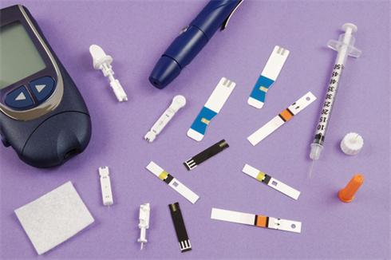
Management: Equipment and Guidelines

Slide 2
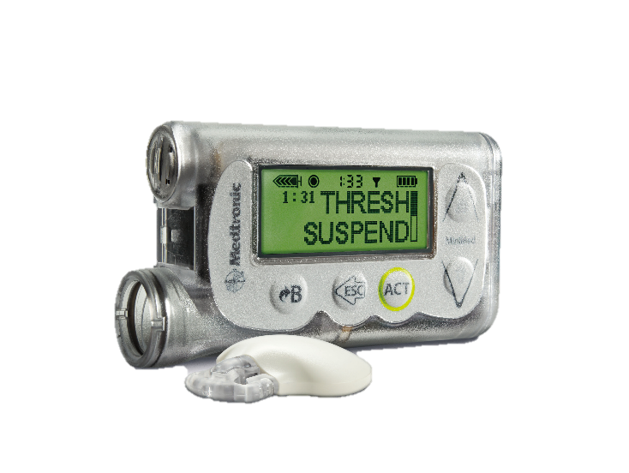
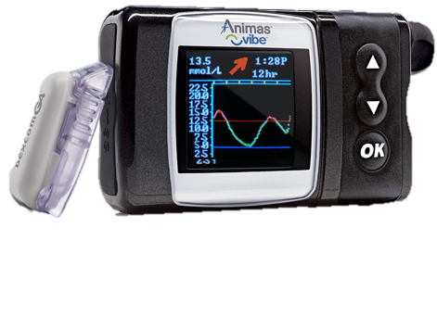
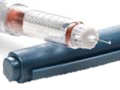
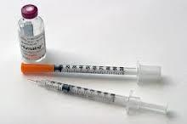
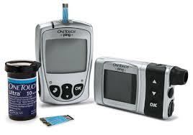
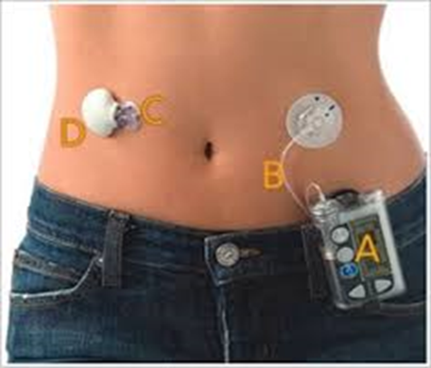
Insulin Delivery:
Injections vs. Pumps

Slide 3
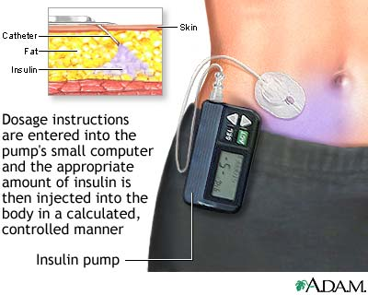
What is an Insulin Pump?
Battery operated device
Reservoir filled with insulin
Computer chip with user control of insulin delivery
Worn 24 hours per day
Delivers only rapid-acting insulin
Notes:
An insulin pump is an external, battery-powered device that continuously delivers insulin in small doses to the body.
Most pumps, like the one on the left in the blue bordered frame, look very much like a pager and can be attached to a belt or waistband, carried in a pocket, or held with a strap around the arm or thigh. The pump contains a cartridge or reservoir of insulin.
These pumps deliver insulin through a tube, as shown in the large picture on the screen. The pump connects to narrow, flexible plastic tubing that ends with a short plastic catheter inserted just under the skin in the abdomen, buttocks, or thigh. Users set the pump to give a steady trickle or "basal" amount of insulin continuously throughout the day. Pumps release "bolus" doses of insulin (several units at a time) at meals and at times when blood glucose is too high based on the user’s programming.
Some pumps , like the one in the lower right in the red bordered frame, are attached directly to the body. This newer kind of insulin infusion pump is often referred to as a patch pump or “pod”. This type differs in that it adheres directly to the skin, without using additional tubing. It is a disposable unit that is controlled by a separate PDM device. In the pod-type pumps, insulin jet injectors send a fine spray of insulin through the skin by a high-pressure air mechanism instead of needles.

Slide 4
Insulin Pump Therapy
Based on what body does naturally
  - Small amounts of insulin all the time (basal insulin)
  - Extra doses to cover each meal or snack (bolus insulin)
Precision, micro-drop insulin delivery
Flexibility
Ease of correction for high blood glucose levels
Notes:
Pump therapy is based on what the pancreas does naturally - delivers small amounts of insulin all the time (basal insulin) - and then at meals or snacks, extra insulin is delivered to cover that amount of food (bolus insulin).
Pumps generally dose rapid acting insulin (occasionally a student may use short-acting or regular insulin)
Students who are on injections use both long and rapid or short acting insulin. Generally their long-acting insulin will be taken either once or twice daily.
The pump delivers insulin in micro-drops that are continuous and accurate. The level of activity directly affects how quickly insulin goes into the bloodstream. When sitting at a desk, it will go into a student’s system more slowly. If the student goes for a walk or a run, it will go into her system much more quickly.
The primary advantage of pump technology is in how it facilitates basal insulin delivery:
It allows for finer adjustment and greater accuracy in fractional doses, for example 2.2 units.
Additionally pump technology is a more convenient way to deliver the multiple bolus doses throughout the day, without having to inject each time.
Those pumps that monitor “on board” or active insulin, also help to prevent overlapping doses that might lead to hypoglycemia.

Slide 5
Dosing with an Insulin Pump
Notes:
An insulin pump delivers one type of insulin – no mixing types.
Newer models have a number of calculation and reminder wizards, for example to assist with calculating insulin bolus dosage based on carbohydrate intake and blood glucose level or to remind users about active insulin while dosing.

Slide 6
What Nurses Should Know About an Insulin Pump
How to deliver routine boluses for carbs and high blood glucose
Signs/symptoms that pump site may need to be changed
When an injection by pen or syringe is indicated
How to disconnect or “suspend” the pump
Notes:
Depending upon the developmental level of the child, the school nurse or trained school personnel may need to perform or assist students with pump functions. Each pump requires specific training.
Some students, especially younger ones, will need assistance with calculating or entering in the correct carbohydrate or blood glucose values, both to cover for meals or snacks and to correct for high blood glucose.
The school nurse or trained school personnel should be aware of the signs and symptoms that a infusion site may need to be changed. Ordinarily, infusion sets are changed every 3 days.
Additionally, the DMMP specifies when an injection by syringe or pen is needed, and when to assist the student as needed in administering insulin by syringe or pen if blood glucose is far above target range, is not responding to a correction bolus, or if ketones are present.
Rarely, a pump may need to be suspended or disconnected if a student becomes unconscious or experiences a seizure. Staff should be trained to perform or assist the student in performing suspensions or disconnections, as per instructions from the parent/guardian or health care provider as specified in the DMMP. For example, some students may disconnect during physical education class or during extracurricular athletics.

Slide 7
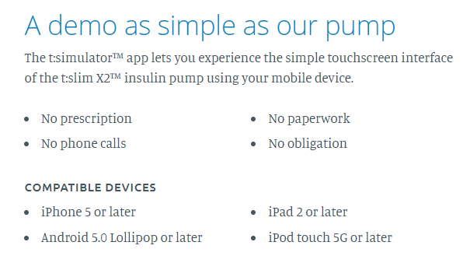
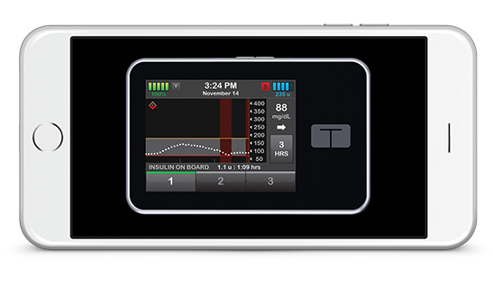
Tandem t:simulator App

Slide 8
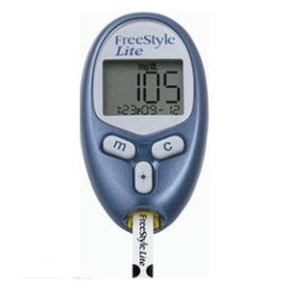
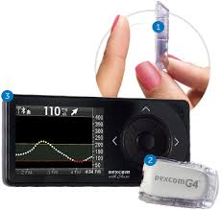
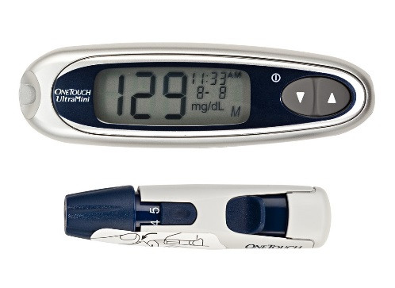
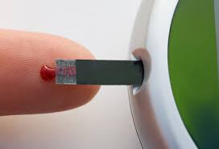
Glucose Monitoring:
Blood vs. Continuous Sensors

Slide 9
Continuous Glucose Monitoring (CGM)
How it works:
  A tiny glucose-sensing device called a "sensor" is inserted just under the skin
  The sensor measures glucose in the tissue and sends the information to a small device or smart device
  Trend arrow at top of graph next to blood glucose number will show whether glucose is steady, dropping, or rising
  The system automatically records an average glucose value every few minutes for up to 3, 5, or 7 days
  Finger stick pokes and regular meter needed to calibrate some models
  Alarms signal when glucose is out of target range
Notes:
In the past few years considerable progress has been made in the continuous monitoring of glucose levels. The steps on the screen explain the basics of how the continuous monitoring technology works:
A tiny glucose-measuring device called a "sensor" is inserted just under the skin.
The sensor measures glucose in the tissue fluids several times a minute and sends the information to a pager-sized device.
The system automatically displays and records an average glucose value every five minutes for up to 3, 5, or 7 days depending on manufacturer.
The state of the continuous monitoring technology is such that finger stick pokes are still required to effectively calibrate the device.
Alarms signal when glucose is out of target range.
While continuous glucose monitors are becoming more common, they are still not widely used. Some individuals use them for a short period to give the health care providers a picture of what is happening with glucose levels between monitoring times, particularly after meals and at night while sleeping.
A student who wears a continuous glucose monitor to school still needs to check blood glucose with a regular meter before treatment.

Slide 10
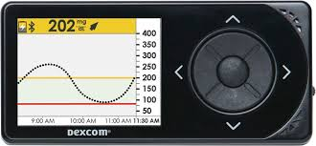

Slide 11
What Are Ketones?
Acids that result when the body does not have enough insulin and uses fats for energy
May occur when insulin is not given, during illness or extreme bodily stress, or with dehydration
Can cause abdominal pain, nausea, and vomiting
Without sufficient insulin, ketones continue to build up in the blood and result in diabetic ketoacidosis (DKA)
Notes:
Ketones are acids that result when the body does not have enough insulin and uses fats for energy.
Ketones may be observed when insulin is not given, during illness or extreme bodily stress, or with dehydration.
Ketones can cause abdominal pain, nausea, and vomiting.
Without sufficient insulin ketones continue to build up in the blood and result in diabetic ketoacidosis (DKA).

Slide 12
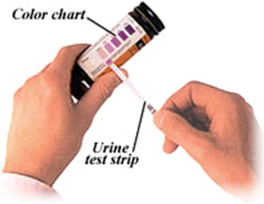
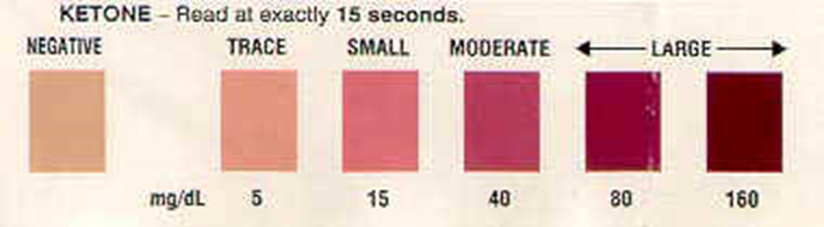
Checking for Ketones
Urine testing
  Most widely used method
Blood testing
  Requires a special meter and strip
  Procedure similar to blood glucose checks
Notes:
Note: Ketones can be measured in either the blood (using a ketone specific meter) or in the urine.
Urine ketone testing continues to be most common in the school setting.

Slide 13
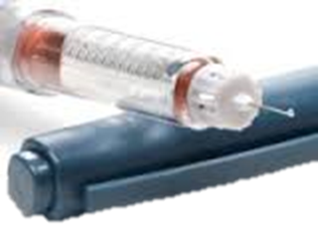
Dosing with an Insulin Pen
Prime: Dial “2” units. If the pen is being used for the first time, prime 4-6 units as per manufacturer’s instruction.
Hold upright. Remove air by pressing the plunger. Repeat “Prime” if no insulin shows at end of needle.
Dial number of units to be administered as per doctor orders.
Notes:
7. Dial “2” units
8. Holding the pen upright, needle end up, press the plunger at the base or bottom of the pen to remove air until a few drops of insulin come out of the end of the needle
9. Dial number of units to be administered as per DMMP
Note: A brand new pen will need to be “primed” with 4-6 units until a few drops of insulin come out of the needle. The purpose of priming is to clear any air out of the syringe that could affect dosing. Priming should be done into the air and not at the student.

Slide 14
Emergencies: What is Glucagon?
Naturally occurring hormone made in the pancreas
A life-saving, injectable hormone that raises blood glucose level by stimulating the liver to release stored glucose
Treatment for severe hypoglycemia
Life-saving, cannot harm a student/cannot overdose
Notes:
Glucagon is a hormone that occurs naturally in the body. It is produced in the pancreas and raises blood glucose levels by causing the release of glycogen (a form of stored carbohydrate) from the liver that raises blood glucose levels.
Glucagon by injection is a life-saving prescription medication (called GlucaGen by one manufacturer). It is given by injection and used to treat serious hypoglycemia. It was created for use by people who are not health care professionals.
If it is specified in the student’s Diabetes Medical Management Plan (DMMP), glucagon should be used when the student is unconscious, experiencing convulsions, or cannot eat or drink safely. Severe hypoglycemia can cause brain damage or death.
While it may cause nausea and vomiting when the student regains consciousness, glucagon is a life-saving treatment that cannot harm a student. Cannot overdose.

Slide 15
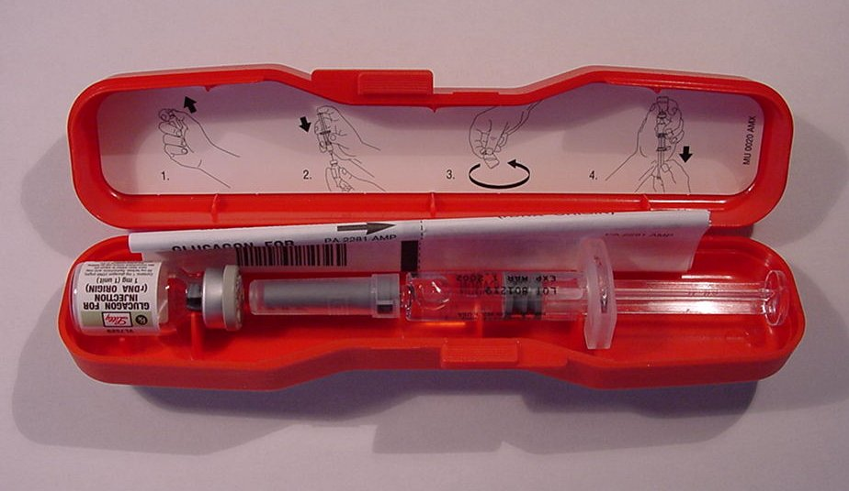
Emergency Kit Contents:
1 mg of freeze-dried glucagon (vial) 1 ml of water for reconstitution (syringe)
Combine immediately before use
Notes:
This photo shows the inside of a glucagon emergency kit. Glucagon must be injected.
Instructions are included in package.
In addition to participating in this training, instructions inside the kit should be reviewed.
Within the glucagon kit are:
a syringe pre-filled with a saline and
a vial of powdered glucagon.
Combine the glucagon for injection immediately before use by following the instructions that are included with the glucagon kit.

Slide 16
Procedure: Act Immediately
If possible check blood glucose, don’t delay
If in doubt, always treat
Position student safely on side for comfort and protection from injury
School nurse or trained personnel notified to give glucagon in accordance with DMMP or emergency care plan
Call 911, parent/guardian, school nurse as per DMMP or emergency care plan
Notes:
If possible, do a blood glucose check.
Don’t delay if a meter is not available and low blood glucose symptoms are being exhibited. If in doubt, always treat.
Position student safely – Be sure that the student is lying on his or her side in a clear, safe area protected from head and bodily injury.
Do not leave student alone.
School nurse or other trained diabetes personnel should give glucagon as soon as possible after discovering that the student is unconscious or unable to swallow.
A second person should call 911, then parent/guardian and school nurse as per DMMP.

Slide 17
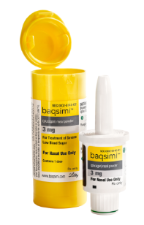
NEW: Baqsimi Glucagon
Dry nasal spray to be given for hypoglycemic emergencies
Dispense once into one nostril
Free trainers available from Lilly

Slide 18
What’s New in Diabetes Technology?
Less math, less pain, fewer fingersticks/injections
Rates of CGM use in school age children have quadrupled in past decade
New terminology: sensor glucose vs. blood glucose
Most leading brands of CGM now within 10% accuracy of the serum glucose
Low Glucose Suspend/ Predictive Low Glucose Suspend
Automated insulin delivery systems still in development: Beta Bionics Bionic Pancreas System combines insulin and also has installed glucagon
May see CGM trend arrows starting to be used in treatment
New split catheters that allow insulin to flow out of two holes (less occlusions)
Insulin pens with built-in Bluetooth, enabling dose data to be sent to a phone

Slide 19
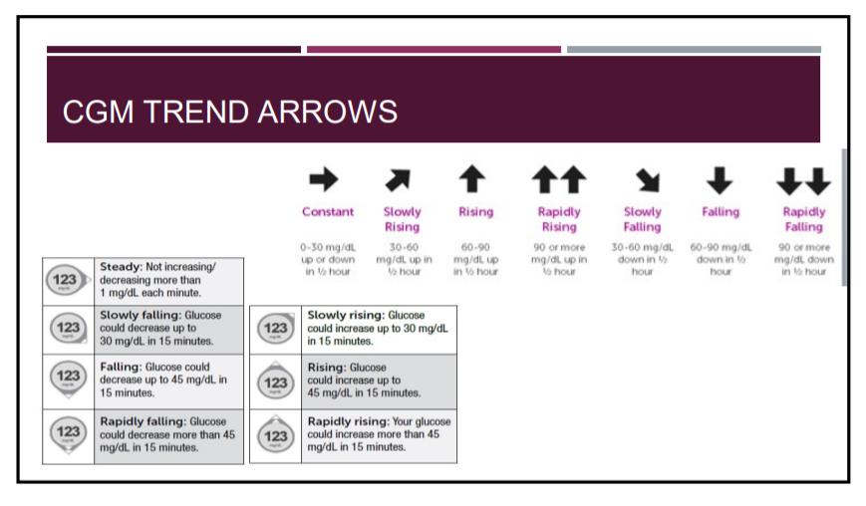

Slide 20
Guidelines: Why are They Needed?
Consistency in district
Easier to defend process when everyone is on same page
Developing/writing/having guidelines forces everyone to look at best practices
All students receive care that is at the same level of standard, especially important for students who move/transfer to another school in the same district
Panel reviewed by experts

Slide 21


Final thoughts…
Ultimately, the school nurse is the “Health Ambassador” of the school and should expect to provide info, education, and guidance to staff on an ongoing, continual basis

