Slide 1
Missouri Small Rural Hospital Improvement Program
FY23: June 1, 2023 – May 31, 2024
Ashlee Griffin, Rural Health Coordinator
Office of Rural Health and Primary Care
Missouri Department of Health and Senior Services
https://health.mo.gov/living/families/ruralhealth/
Notes:
Good morning! Welcome to the Missouri Small Rural Hospital Improvement Program Kick off webinar

Slide 2
Welcome!
All participants are muted upon entry.
This presentation will be recorded and available for all participants.
Feel free to ask questions in the chat box or raise your hand throughout the presentation.
Notes:
I would like to start off by thanking you for joining us today! I want to go over some general housekeeping items. All participant lines have been muted upon entry, if you have a question, please use the chat feature or you can unmute yourself by using the spacebar. I would also like to request everyone to drop their name and organization in the chat so we know who all is in attendance today. If you are attending with more than one person, please list everyone that is viewing today. This will be recorded and available for future reference on the Missouri SHIP webpage.

Slide 3
This presentation is supported by the Health Resources and Services Administration (HRSA) of the U.S. Department of Health and Human Services (HHS) as part of an award totaling $545, 792 with zero percentage financed with non-governmental sources. The contents are those of the author(s) and do not necessarily represent the official views of, nor an endorsement, by HRSA, HHS, or the U.S. Government.
Notes:
This is just to inform you that the SHIP program is funded by Health Resources and Services Administration also known as HRSA.

Slide 4
What is Ship?
The Small Rural Hospital Improvement Grant Program (SHIP) administered by the Department of Health and Senior Services (DHSS) is supported by the U.S. Department of Health and Human Services, Health Resources and Services Administration (HRSA) Federal Office of Rural Health Policy (FORHP).
Section 1820(g)(3) of the Social Security Act (SSA) authorized SHIP to assist eligible hospitals in meeting the cost of implementing data system requirements established under the Medicare Program, including using funds to assist hospitals in participating in improvements in value and quality to health care.
https://health.mo.gov/living/families/ruralhealth/ship.php
Notes:
What is SHIP? SHIP is The Small Rural Hospital Improvement Program (SHIP) administered by the Department of Health and Senior Services (DHSS) and is supported by the U.S. Department of Health and Human Services, Health Resources and Services Administration also know as (HRSA) along with the Federal Office of Rural Health Policy also known as (FORHP).
SHIP is designed to assist eligible hospitals in meeting the cost of implementing data systems and participating in improving the value and quality to health care.
At the bottom of the page we have provided the link to the Missouri SHIP webpage for reference in the future

Slide 5
Allowable Investment activities
Value Based Payment (VBP) – Quality Reporting Data Collection Training or Software, HCAHPS, Efficiency or Quality Improvement Training, Provider Based Clinic Quality Measures Education, Alternative Payment Model and Quality Payment Program Training
Accountable Care or Shared Savings (ACO)– Computerized Provider Order Entry Implementation, Pharmacy Training, Population Health, Social Determinates, Quality Improvements, Systems Performance Training, Telehealth and Mobile Health, Community Para medicine, HIT Training
Payment Bundling (PB) or Prospective Payment system (PPS) – ICD-10 Software, ICD-10 Training, Efficiency or Quality Improvement, S-10 Cost Reporting Training, Price Transparency training
Notes:
Let’s talk about allowable investment activites. In the SHIP program, each hospital must select which allowable investments they wish to spend there funds on. There are three categories of Investments to choose from. Those categories are:
Value Based Payment (VBP) – which includes Quality Reporting Data Collection training or software, HCAHPS, Efficiency or Quality Improvement training, Provider Based clinic quality measures education and Alternative Payment Model and Quality Payment Program Training
Accountable Care or Shared Savings (ACO)– which includes Computerized Provider Order Entry Implementation, Pharmacy Training, Population Health, Social Determinates, Quality Improvements, Systems Performance Training, Telehealth and Mobile Health, Community Para medicine and HIT Training
Payment Bundling (PB) or Prospective Payment system (PPS) – Which includes ICD-10 Software, ICD-10 Training, Efficiency or Quality Improvement, S-10 Cost Reporting Training and Price Transparency training
Examples of each investment activity can be found on the National Rural Health Resource Center web page:
The Small Rural Hospital Investment Activity Examples for FY23, should have been provided to you during the application process.
That brings us to our new best friend, The Allowable Investment Resources.

Slide 6
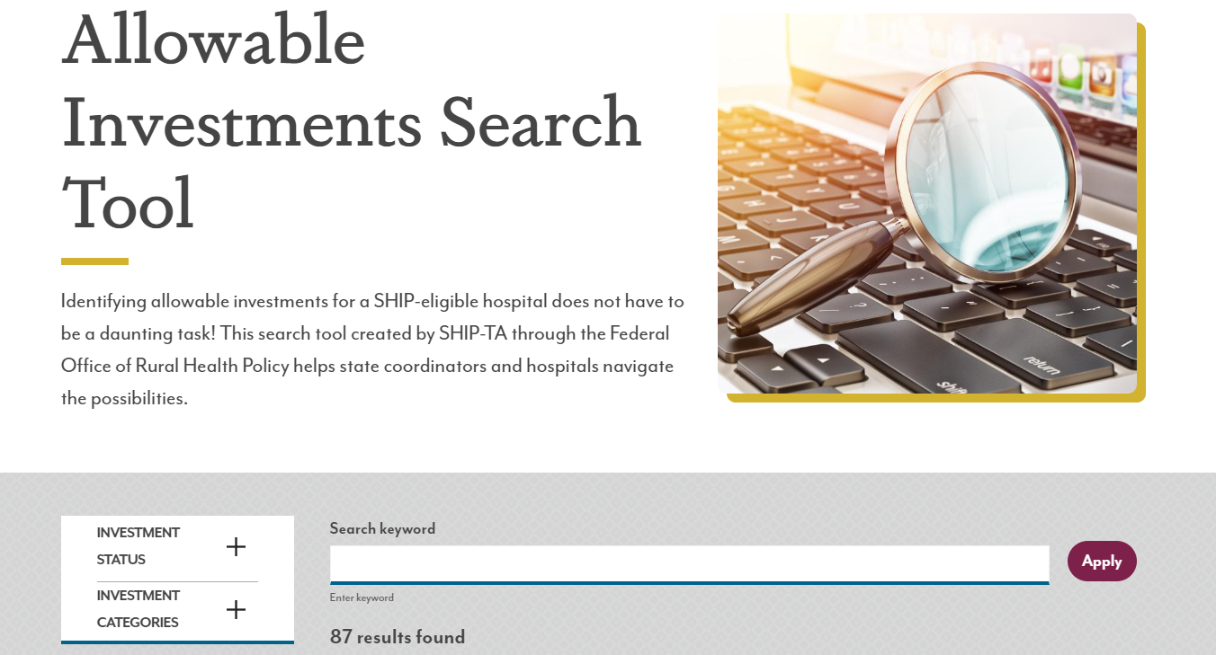
Allowable Investment Resources
Allowable Investments Search Tool:
https://www.ruralcenter.org/programs/ship/allowable-investments/search-tool
Notes:
The Allowable Investments Search Tool, will allow you to input any questioned expenditure into the search bar to find out if your selection is allowable. When searching sometimes you can start very specific and then go broad if you are not finding what you are looking for, I am always happy to help also! You will also get a pdf version of the Allowable Investment document, I would highly suggest to scroll through all the pages to become familiar with the categories. I find that there is often an unexpected ways for your investment to be allowable as well as things that you were not aware of that would be allowable.
Of course, always feel free to reach out to us for any questions and keep in mind that trainings should be approved in advance and cannot be for management.

Slide 7
SHIP FY23 Priorities
Critical Access Hospital | NON-Critical Access Hospital
Priority One: MBQIP reporting www.hrsa.gov/rural-health/rural-hospitals/mbqip | Priority One: ICD-11 Readiness
Priority Two: ICD-11 Readiness
Notes:
This year was a competitive grant year and HRSA has some new SHIP priorities depending on your facility type. These priorities mean, that you must prioritize these activities before selecting any other allowable investment activity.
If you are Critical Access Hospital, you have two priorities.
First would MBQIP data reporting. I will provide some additional resources about MBQIP reporting also. We also have a flex program to assist with MBQIP data reporting.
The next priority for Critical Access Hospitals and NON Critical Access Hospitals alike is ICD-11 readiness. You will recall attesting to the understanding that ICD-11 will roll out with in the next 5 years.
All hospitals must prioritize ICD-11 coding readiness and/or the implementation those activities.

Slide 8
What does ICD-11 readiness mean?
Priority Investment: implementation requirements during the FY23-FY27 grant cycle.
Are you ICD-11 Ready?
Selected an ICD-10 investment activity in FY23?
Implemented computer software upgrades to support a future transition to ICD-11?
This can be operating systems or specific coding systems
Transitioned to an online coding system that will automatically make ICD-11 available when appropriate?
Upgraded or implemented telehealth software and hardware to take advantage of new/updated ICD-11 codes for telehealth/telemedicine services?
Notes:
“ICD-11 Readiness” indicates that a facility, system or otherwise, is preparing (or has prepared) for a transition to a new system of medical coding with the intent to maintain an accurate billing systems.
The current understanding and expectation is that the official announcement and implementation requirements will occur during the FY23-FY27 grant cycle and therefor the readiness priority is to allow hospitals to begin the transition process in advance.
You may already be considered ICD-11 ready or be on your way to readiness if you plan to or have begun or implemented any of the following:
If you have selected and ICD-10 investment activity in FY23
If you have implemented computer software upgrades to support a future transition to ICD-11. This can be operating systems or specific coding systems.
If you have transitioned to an online coding system that will automatically make ICD-11 available when appropriate.
If you have upgraded or implemented telehealth software and hardware to take advantage of new/updated ICD-11 codes for telehealth and or telemedical services.
Cont to next slide

Slide 9
What does ICD-11 readiness mean? Cont.
Are you ICD-11 Ready?
Implemented a training related to the Social Determinants of Health and/or Population Health Training (with the intent to use new ICD-11 or Z-codes)?
Undergone an efficiency or QI training to train staff on implementing ICD-11 plans and initiatives to minimize impact to patients and staff?
Provided trainings that update and/or computerize hospital policies and procedure to prepare for ICD-11?
Compliance with the ICD-11 priority can include an existing expense used for ICD-11 readiness.
Utilized SHIP funds at any point during the current grant (FY23) period for ICD-11 preparedness?
Notes:
“ICD-11 Readiness” indicates that a facility, system or otherwise, is preparing (or has prepared) for a transition to a new system of medical coding with the intent to maintain accurate billing systems.
The current understanding and expectation is that an official announcements and implementation requirements will occur during the FY23-FY27 grant cycle and thus the readiness priority is to allow hospitals to begin the transition process in advance.
You may already be considered ICD-11 ready or be on your way to readiness if you plan to or have begun or implemented any of the following:
If you have implemented a training related to the Social Determinants of Health and/or Population Health Training (with the intent to use new ICD-11 or Z-codes).
If you have undergone an efficiency or QI training to train staff on implementing ICD-11 plans and initiatives to minimize impact to patients and staff.
If you have provided trainings that update and/or computerized hospital policies and procedure to prepare for ICD-11. Compliance with the ICD-11 priority may be as simple as identifying an existing expense as one that can be used for ICD-11 readiness.
If you plan to or will utilize SHIP funds at any point during the FY23 grant period for ICD-11 preparedness.

Slide 10
FY23 SHIP Funding Overview
41 MO Participating Hospitals
$10,933.00
Notes:
Here is the funding over view……Missouri has 48 SHIP eligible hospitals, with 41 participating in FY23. Each hospital will be awarded up to $10,933.00 in reimbursement for approved investment activities.

Slide 11
FY23 Category Selections
Notes:
As we talked about before, SHIP focuses on 3 investment categories. Value Based Purchasing, Accountable Care Organization, Payment Bundling or Prospective Payment System. This pie chart shows an over view of the percentage each category was selected by our 41 participating hospitals.

Slide 12
Prepare for Successful FY23 Grant Cycle
Review approved application. If needed, request copy via email.
Make sure requested activities are still planned.
Review activity costs to ensure all funds will be expended.
Request prior approval, if needed: No later than November 30th
Notes:
We understand there can be issues with selecting activities a year in advance when the grant doesn’t start until June. To combat these issue, we highly recommend that you review your approved SHIP applications at the start of the grant period and ensure that the requested activities are still relevant and planned to occur during this grant period. Then, review the costs of the activities to determine if you will have enough expenses to reach the maximum fund of $10,933.00. If any activity changes are needed, you will need to submit a Change request form and get prior approval by November 30th . I will discuss the prior approval process in more detail in a little bit.
To comply with HRSA guidelines, you are also being asked to develop a program goal and reporting measures, these are what we refer to as SMART, for each selected activity.
Now Let’s talk about Smart Goals.

Slide 13
SMART Goals
SMART:
Specific
Measurable
Attainable/Achievable
Relevant
Time Bound
Writing Smart Objectives
https://www.cdc.gov/dhdsp/evaluation_resources/guides/writing-smart-objectives.htm
Notes:
SMART stands for Specific, Measurable, Attainable or Achievable, Relevant, and Time Bound, these goals are designed to provide you with a action plan on making improvements to your selected activity. SMART goals can be very beneficial in determining the benefit of your chosen activity. You will have a specific goal, an plan of action to measure and achieve your goal, understand how your actions are relevant to your goal and lastly the time frame you want to achieve your goal in. A few examples of SMART Goals will be things like working toward improving your Star rating, increasing # of completed HCAHPS surveys, decrease claims denials based on coding errors, tracking # of patients served with your SHIP funded telehealth hardware or software, tracking the use of your price transparency software or webpage. I have included a link that can give you some guidance on writing your SMART goals. If you still need guidance please reach out to me and I will be happy to help you!
That leads us to reporting.

Slide 14
Reporting and invoice Requirements
SHIP FY23 will require quarterly reporting and invoicing by all participating hospitals.
Quarter | Reporting Period | Due Dates
1 | June 1 – August 31 | September 10
2 | September 1 – November 30 | December 10
3 | December 1 – February 28 | March 10
4 | March 1 – May 31 | June 10
Notes:
Just like last year, quarterly reports and invoices will be required for all hospitals. They are both due within 10 days from the end of each quarter, the due dates are provided here. Like past years, the report survey link will be sent the last week of each quarter. I want to throw out a gentle reminder, and I know that we all are going to but, I would rather say it up front rather than when it is to late, if you fail to report, you will not be eligible to participate in SHIP grant the following year. Also if there is a change in staff please let us know so we can update our contact’s and there is not any missed information.

Slide 15
Progress Reports
Quarterly progress reports will allow the hospitals and ORHPC staff to monitor progress and ensure that allowable activities are performed and all available funds will be expended before the end of the grant cycle.
ORHPC will provide a survey link to complete each progress report prior to the end of each reporting period.
Please make sure you are able to receive emails from ORHPCinfo@health.mo.gov, to receive correspondence!
Notes:
Quarterly progress reports allows our office and your facility to monitor your project progress and ensure that allowable activities are being performed. This will also ensure that all available funds are expended prior to the end of the grant cycle.
Always feel free to reach out to me if you have any issues with accessing or completing the surveys or any questions in general, I am happy to help and it is better to get ahead of any concerns then to scramble at the last minute to figure it out.
One last thing in regards to reporting…..make sure that you are receiving emails from the ORHPCinfo email address as that is where ALL correspondence in regards to reporting and invoicing will come from.

Slide 16
Progress Reports
Reports shall include achievements made during the period and indicate if the proposed activity(s) chosen from the purchasing menu:
Have been performed and how;
If there are any significant differences between the budgeted and actual activities and how SHIP funds were used to support those activities; and,
Progress tracking for each activity goal.
If there are any current and anticipated challenges to completing the activities in the current contract period and how they were (or will be) resolved.
Notes:
The survey’s will ask questions about the proposed activities each hospital has selected in the application process of this grant, which was in December 2022. The reports will be very similar to prior years but hospitals will be required to provide more information about progress, impacts, and tracking applicable measures. This is where the SMART goals come in at, if your SMART goal is strong then reporting will be easy. We want to make this process as easy on all parties as possible.

Slide 17
Quarterly Invoices
Invoices are required to be submitted on a quarterly basis, with the progress report, as funds are expended.
Invoices should include goods or services received during the reporting period.
Pre-payment of services is not allowed, unless it is a subscription.
Vendor Request for Payment must be submitted with supporting vendor documentation/invoices.
The invoice and DH-38 will have to be one document when uploading it in the survey; if you have issues, you can email it to ORHPCinfo@health.mo.gov.
Notes:
The surveys will ask questions regarding any invoices, progress or concerns that you may have been submitted during the reporting. You must submit a completed Vendor Request Form also known as a DH-38 along with the original invoice from the vendor. To upload this document into Qualtrics which is the survey platform, all of the documents will need to be combined as one document. I can help you with that if you need also. If you have questions about this or anything that needs to be submitted please don’t hesitate to reach out to me, as I am happy to help.

Slide 18
Vendor Request for Payment Form
Fields must match EXACTLY to Missouri Buys registration.
Any forms with differing information will be rejected by accounts payable.
https://missouribuys.mo.gov/
MissouriBUYS@mo.gov
Invoice #: your own assigned unique invoice number – cannot be the same as any other invoice # submitted to State of MO.
Vendor Remit to Address: must match Missouri Buys exactly.
Vendor #: TIN plus any additional character assigned in Missouri Buys.
Contract Name/Service: SHIP.
Notes:
You vendor request form also known as the DH-38 must match MO Buys registration exactly. Any form with differing information will be rejected by accounts payable and will result in a delay in getting any payments.
One of the biggest issue we have is Mis-matched address’s. The address on the form must match MOBUYS, whether that be physical address, PO Box, or a corporate address. They must match exactly.
I can’t stress this enough, we don’t want anything stopping you from receiving your funds if at all possible.

Slide 19
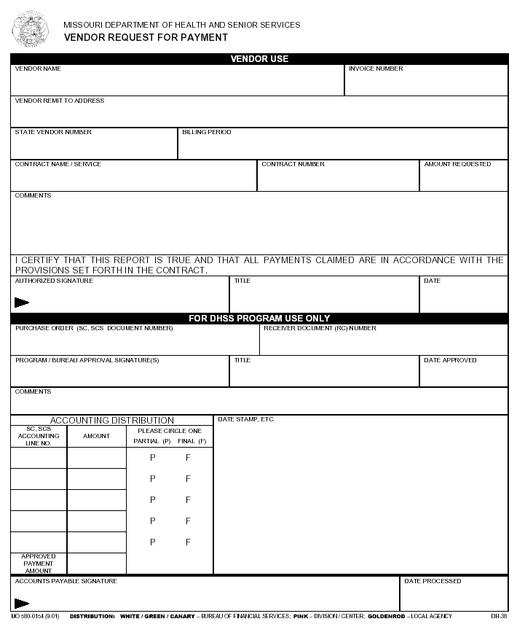
Vendor Request for Payment Form
These fields are required.
Incomplete forms will be
returned for completion.
Notes:
This is a copy of the Vendor Request for Payment Form a DH-38, which you will have to fill out to receive any payment. The fields with a red star are required. If fields are blank or incorrect, the form will be returned for revision or completion. Please ask questions if you are not sure how to complete this form, I am happy to help or help get the information that you need for to get this completed.

Slide 20
Prior Approvals
Prior Approvals are required when a hospital requests to change funding activities from those selected at the time of the application.
This includes changes to approved application budgets.
All Prior Approvals must be submitted via e-mail (ORHPCinfo@health.mo.gov).
All requests must be submitted prior end of 2nd quarter (11/30/2023).
Notes:
Prior Approvals were mentioned earlier, and a prior approval is needed when a hospital wants to change or add investment activities. This change has to be done prior to the end of 2nd quarter which is 11/30/2023 per HRSA. Our office has been very lenient with approvals in the past but we cannot continue to do so. This is why it is so important to now, look back at your applications and budgets and request any changes as soon as possible. If you would like to see what was submitted on your application for FY23, please let me know and I will be happy to provide that to you!

Slide 21
SHIP Resources
MO SHIP Webpage | https://health.mo.gov/living/families/ruralhealth/
Allowable Investment Search Tool | https://www.ruralcenter.org/ship/allowable-investments/search-tool
Value Based Purchasing Investments | https://www.ruralcenter.org/ship/allowable-investments/value-based-purchasing
ACO or Shared Savings Investments | https://www.ruralcenter.org/ship/allowable-investments/accountable-care-organizations
Notes:
Here are some valuable resources that can be helpful to you.
The first link is the MO SHIP webpage, that tells you about the Missouri SHIP program
The next link is the Allowable Investments tool – which I provided earlier also to give you guidance on your selected activities
The next couple of links are resource tools that specifically talk about a couple of the activities that can be chosen. These links are on the National Rural Health Resource Center website. The Center is contracted by HRSA to provide technical assistance for the SHIP grant and for all entities involved in the SHIP Grant.

Slide 22
SHIP Resources
PB or PPS Investments | https://www.ruralcenter.org/ship/allowable-investments/payment-bundling
CMS Hospital Price Transparency | https://www.cms.gov/hospital-price-transparency
MBQIP Resources | www.hrsa.gov/rural-health/rural-hospitals/mbqip (and) www.ruralcenter.org/resource-library/mbqip-measures
3RNet | https://www.3rnet.org/
Rural Spotlight Blog | https://ruralhealthinfocenter.health.mo.gov/
Notes:
Cont…..
The next link is for the CMS Price Transparency page. Price Transparency was added to the ship menu last year.
We have also included the 3RNet website for staffing assistance if that may be needed.
Lastly this is our Rural Spotlight Blog and we post all kinds of valuable information for our Rural providers and communities. Check it out link and get signed up to receive blog posts, so you don’t miss any important information about what is going on in your Rural Community. If there is something going on in your community and you think everyone should know, send it to us and we will see about helping you spread the word.

Slide 23
Stroudwater Associates
Stroudwater Associates, in partnership with the Missouri Office of Rural Health and Primary
Care, will be working with MO CAH’s to implement and successfully sustain quality improvement strategies and support participation in the MBQIP program.
Contact The Stroudwater Team
Carla Wilber, Senior Consultant: cwilber@stroudwater.com
Lindsay Corcoran, Senior Consultant: lcorcoran@stroudwater.com
Christie Bishop, Consultant: cbishop@stroudwater.com
Megan Zook, Project Coordinator: mzook@stroudwater.com
Program activities include:
Quarterly/Bi-Annual Meetings
Education Session
Peer-2-Peer Learning
QI-MBQIP Technical Assistance
Stroudwater: https://www.stroudwater.com/
Notes:
We wanted to include a couple of additional resources that may be beneficial to you if you are also Critical Access Hospital. Stroudwater has a wide variety of resources for your facility and they are included in the SHIP program so please check out there website and if there is anything you may be able to utilize please let us know and we will be happy to make that connection for you.

Slide 24
Warbird Consulting partners
Warbird Consulting Partners is here to provide our member with Operation and Financial resources. The Warbird RCO team is available to answer questions, assist with strategy, discuss operational issues and address revenue cycle concerns. These services are supported and funded by the Missouri Department of Rural Health.
Program Activities Include:
Pricing Transparency Reviews
Revenue Capture Assessments
Policy and Procedure Reviews and Modifications
Educational Webinars
Strategic Pricing Analysis
No Surprises Act Discussion
Operational Strategy Sessions
Contact the Warbird Team
John Behn, Senior Consultant:
jbehn@warbirdcp.com
603-801-2027
Warbird Consulting: https://warbirdconsulting.com/
Notes:
Another good resource for your hospital is Warbird Consulting Partners, they have a wide variety of resources for your facility and they are included in the SHIP program also, so please check out there website and if there is anything you may be able to utilize please let us know and we will be happy to make that connection also.
MBQIP (www.hrsa.gov/rural-health/rural-hospitals/mbqip) and (www.ruralcenter.org/resource-library/mbqip-measures)

Slide 25
ORHPC Contact Information
Sara Davenport – Office Chief
Shirley Murphy – Rural Health Manager
Primary Contact: Ashlee Griffin– Rural Health Coordinator
Email: ORHPCinfo@health.mo.gov
Phone: 573-751-6441
Webpage: https://health.mo.gov/living/families/ruralhealth/
SHIP Webpage: https://health.mo.gov/living/families/ruralhealth/rural-health- hospitals.php
Rural Spotlight Blog: https://ruralhealthinfocenter.health.mo.gov/
Notes:
That brings us to the contact information for our office. Our amazing Chief, Sara Davenport, and our amazing Rural Health Manager, Shirley Murphy and myself. You can reach me by phone 573-751-6441 or email at ORHPC@health.mo.gov at any time. I am happy to help and no question is a stupid question. I would rather answer questions ahead of time than be in a situation after the fact ☺

Slide 26
Questions?
Notes:
What questions do you have? Please use the raise your hand feature or type in the chat box to ask questions and I will be happy to get those answered for you!

Slide 27
Thank you
For more information contact
Missouri Department of Health and Senior Services
ORHPCinFO@health.mo.gov
Phone: 573-751-6441
Notes:
If we have no further questions, we will close the SHIP Kick off webinar now, enjoy your day and thank you joining us!

