Slide 1
Missouri Opioid Overdose and Bloodborne Infection Vulnerability Assessments
2022

Slide 2
Purpose of Today’s Meeting
Review the 2020 vulnerability assessments and the 2022 updates
Gather feedback on the vulnerability assessments
Feedback will be considered during creation of the 2022 update report.
Feedback will also be considered during development of any future vulnerability assessments projects, including aspects such as
Methodology changes
Data source changes
Discuss the impact of COVID-19 on opioid overdoses and bloodborne infections
Collect input on how the results of the assessments could be used to target services

Slide 3
Situation
The Missouri Department of Health and Senior Services (DHSS), local public health agencies (LPHAs), and partners are responding to the opioid epidemic but have limited resources.
The ability to accurately describe and measure the epidemic is critical for utilizing available resources and providing effective responses.

Slide 4
Original Project Background
In 2016, the Centers for Disease Control and Prevention (CDC) published the County-level Vulnerability Assessment for Rapid Dissemination of HIV or HCV Infections Among Persons Who Inject Drugs, United States (also referred to as the National Vulnerability Assessment.) This resource identified 13 Missouri counties as vulnerable, but data indicate that many other counties in the state may also be at risk of opioid overdoses and bloodborne outbreaks related to nonsterile drug injection.

Slide 5
Original Project Background (continued)
In summer 2018, the CDC awarded one-year Opioid Crisis Supplemental Funding through the Cooperative Agreement for Emergency Response: Public Health Crisis Response.
The opioid crisis funding covered multiple projects from three different CDC centers.
The project proposed by the National Center for HIV/AIDS, Viral Hepatitis, STD, and TB Prevention (NCHHSTP) required awardees to develop and disseminate jurisdiction-level vulnerability assessments that identify subregional areas at high risk for:
Opioid overdoses
Bloodborne infections associated with nonsterile drug injection

Slide 6
Original Project Purpose
Awardees will use findings from the assessments to develop plans that strategically allocate prevention and intervention services.
Awardees will distribute findings to key stakeholders in formats that support action.
Services will be targeted to maximally reduce risk of overdoses and risk of bloodborne infection spread through nonsterile drug injection.

Slide 7
2019 Vulnerability Assessment Development
NCHHSTP funding was assigned to the DHSS Bureau of Reportable Disease Informatics (BRDI).
BRDI convened an internal workgroup of DHSS stakeholders to develop the document. Workgroup members included staff with knowledge and experience related to the opioid epidemic, bloodborne outbreaks, and/or data analysis and reporting.
The internal workgroup reviewed previously created data sources.
Internal workgroup members participated in multiple calls with the CDC project team as well as staff from other states working on the same project.

Slide 8
2019-2020 Stakeholder Feedback
The project required that awardees engage stakeholder groups to:
Provide input on the vulnerability assessments’ design
Support development of data use agreements if needed
Inform the use of the assessments’ findings to target services that will maximally reduce risk of overdoses and risk of bloodborne infection spread through nonsterile drug injection
In 2019, DHSS obtained feedback through:
Internal workgroup meetings
Stakeholder meetings in each of Missouri’s six HIV Care Regions
DHSS continued to gather feedback after the publication of the report.

Slide 9
2019 Indicator Selection
The internal workgroup considered a long list of indicators for inclusion in the vulnerability assessments.
An indicator could be used only if reliable data were available for all 115 counties. As a result, many indicators were excluded. These indicators are described on pages 55-64 of the 2020 report, which is available at https://health.mo.gov/data/opioids/assessments.php.

Slide 10
Indicators Included in the 2020 and 2022 Assessments
Opioid Overdoses | Both Assessments | Bloodborne Infections
Opioid-related substance use disorder treatment (SUDT) admissions | Drug overdose deaths | Bloodborne illnesses (HIV, acute and chronic hepatitis B, and acute and chronic hepatitis C)
Poor mental health days (2022 indicator change detailed on next slide) | Opioid misuse emergency room (ER) visits | Hepatitis C virus among ages 18 to 40
 | Drug-related arrests | Injection drug use (IDU) among persons receiving SUDT
 | Median income
 | Poverty
 | Lack of a high school education
 | Unemployment
 | Uninsured
Data sources are listed in the 2020 assessments report at https://health.mo.gov/data/opioids/assessments.php

Slide 11
Poor Mental Health Days Indicator Source
2020: Self-reported frequent (>14 per month) poor mental health days from 2016 Missouri County-Level Study
2022: Average number of mentally unhealthy days reported in the past 30 days (age-adjusted) from the 2018 Behavioral Risk Factor Surveillance System (BRFSS) as reported in the County Health Rankings
Reason for Change: The Missouri County-Level Study has not been updated since 2016.
All other indicators remained the same and were obtained from the same source datasets. Details on indicator sources are provided in Appendix C of the 2020 assessments report at https://health.mo.gov/data/opioids/assessments.php.

Slide 12
Ranking Methodology Selection
The internal workgroup considered several factors when determining a ranking methodology for the assessments.
Amount of time required for development
Availability of staff with statistical expertise
Ease of explanation to stakeholders
Flexibility if additional indicators are identified from stakeholder feedback

Slide 13
Ranking Methodology – Indicator Ranks
For each indicator, the 114 counties and the City of St. Louis were ranked from 1-115 based on their rates.
The county with the best health outcome was ranked 1, while the county with the worst outcome was ranked 115.
For some indicators (e.g., median income), the highest rate is the best.
For other indicators (e.g., poverty or bloodborne illnesses), the lowest rate is the best.
Tied counties were all assigned the same rank number.

Slide 14
Ranking Methodology – Summed Ranks
The individual indicator ranks for each county were summed, as shown in Appendix A of the 2020 assessments.
These sums were then ranked. Higher sums indicate greater vulnerability. (In the example below, Atchison would be considered the more vulnerable of the three counties listed.)

Slide 15
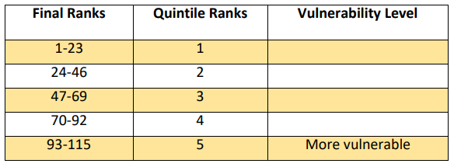
Ranking Methodology - Quintiles
Quintile rankings were assigned based on the summed rank position. The 20% (or 1/5) of counties with the highest summed ranks fall into quintile 5. Thus, the counties in quintile 5 are considered to be more vulnerable.

Slide 16
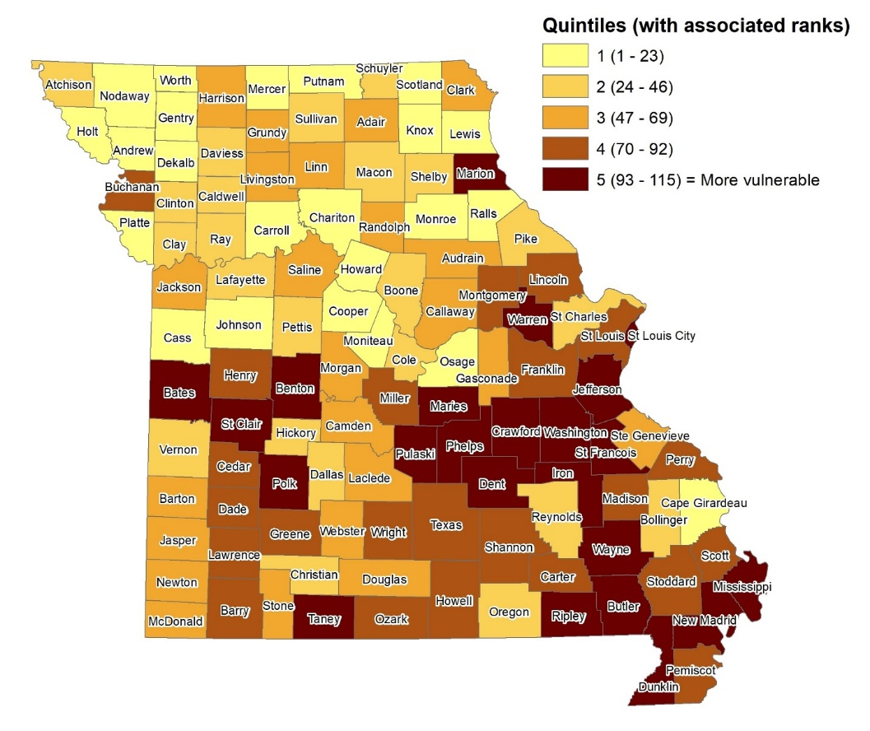
2020 Results – Opioid Overdose Vulnerability Assessment

Slide 17
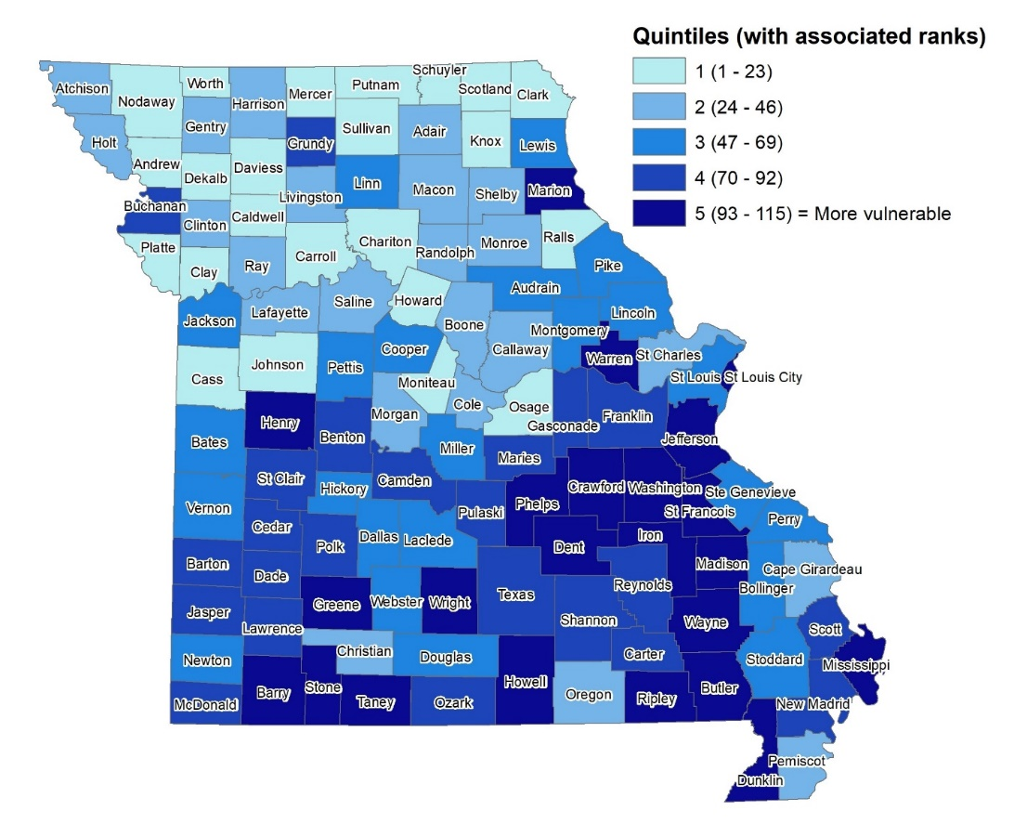
2020 Results – Bloodborne Infections Vulnerability Assessment

Slide 18
2022 Update
DHSS received funding through the Overdose Data to Action grant to update the assessments.
DHSS utilized the same methodology with more recent data to calculate the 2022 assessments.
Use of the same methodology allows for direct comparison of the 2020 and 2022 findings.
The only changes in the process of calculating the original 2020 assessments and the 2022 updates were:
Use of updated data from each dataset
Replacement of the mental health indicator due to lack of updates to the original source

Slide 19
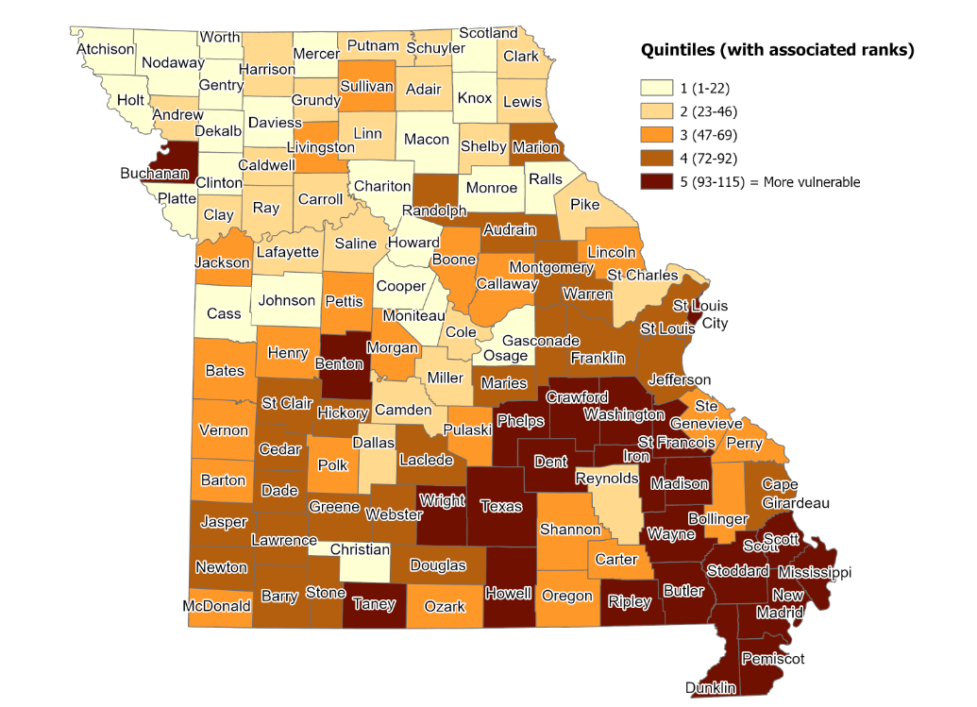
2022 Results – Opioid Overdose Vulnerability Assessment

Slide 20
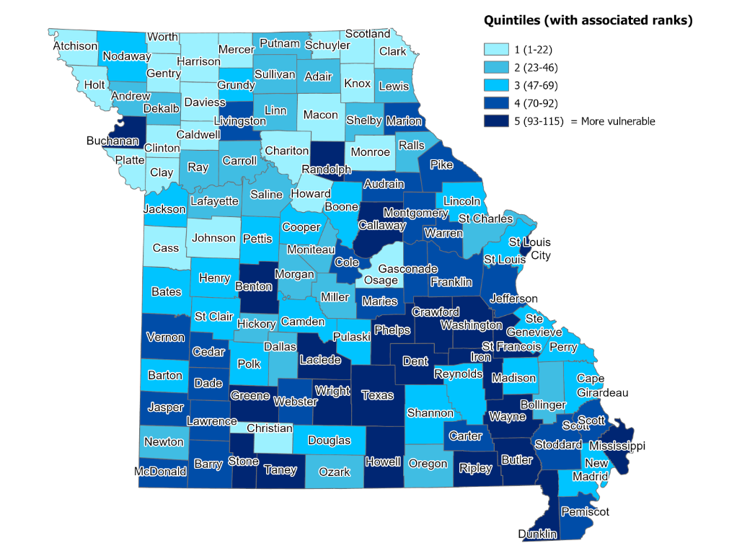
2022 Results – Bloodborne Infections Vulnerability Assessment

Slide 21
Discussion Topics
Do the results of the vulnerability assessments match your expectations?
Are any changes to data sources/indicators needed for future vulnerability assessment updates?
Are any changes to the assessment methodology needed for future vulnerability assessment updates?
How has COVID-19 impacted opioid overdoses and bloodborne outbreaks?
How can the assessment results be used to better target services?

Slide 22
Next Steps
DHSS will publish finalized assessment materials, including county-specific data and resource profiles
DHSS will promote finalized assessment materials through general outreach events such as conferences, exhibits, meetings, etc.
DHSS will consider stakeholder feedback in determining need for future vulnerability assessment updates
What other next steps are needed?

Slide 23
Thank you!
Vulnerability assessment resources are available at https://health.mo.gov/data/opioids/assessments.php
Contact Information:
Missouri Department of Health and Senior Services
Division of Community and Public Health
Data Modernization / Interoperability Team
573-522-2808

