Slide 1
Spring Cleaning for
Falls Prevention
Checklists, video, and images

Slide 2
Slide title
Fall Prevention Checklists
Two pages: https://uvahealth.com/sites/default/files/2018-08/Fall-Prevention-Checklist.pdf
Eight pages: https://www.cdc.gov/transportationsafety/pdf/older_adult_drivers/CDC-MyMobilityTool.pdf
Eight pages: https://www.cdc.gov/steadi/pdf/check_for_safety_brochure-a.pdf
Tri-fold pamphlet: https://wwwn.cdc.gov/pubs/#/300287

Slide 3
https://www.youtube.com/watch?v=3YI5QP-eWAA

Slide 4
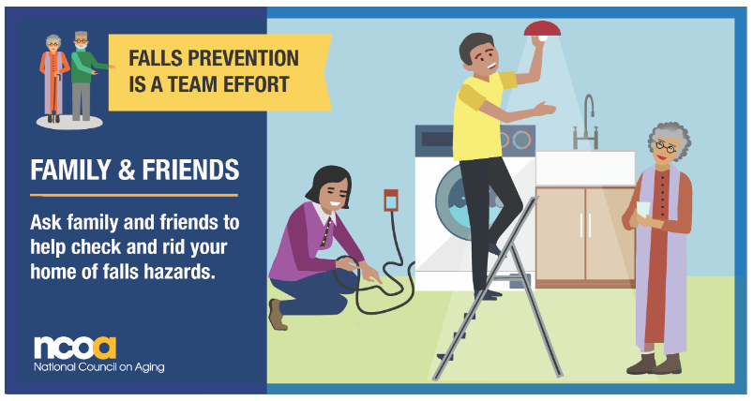

Slide 5
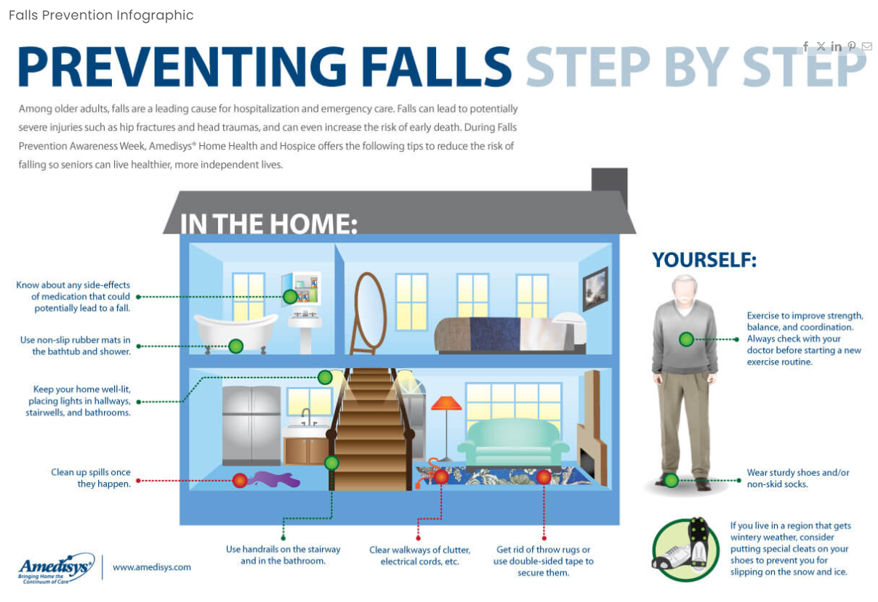

Slide 6
