Slide 1
Missouri OASIS Updates
Rita Craighead, MSN, RN, COS-C
Bureau of Home Care and Rehabilitative Standards

Slide 2
Objectives
Define OASIS Coordinator Roles
Provide Information for Educational Materials
Share Missouri OASIS Statistics
OASIS and the Survey Process

Slide 3
OASIS Coordinators
Each state has designated OASIS Coordinators to provide guidance on the administration and submission of the OASIS instrument.
Downloadable document containing a list of State Agency and CMS office contacts for both OASIS Education and Automation Coordinators available at https://www.cms.gov/Medicare/Provider-Enrollment-and-Certification/SurveyCertificationGenInfo/OASIS-Coordinators
OASIS Education Coordinator – OEC
Rita Craighead
OASIS Automation Coordinator – OAC
Debi Siebert

Slide 4
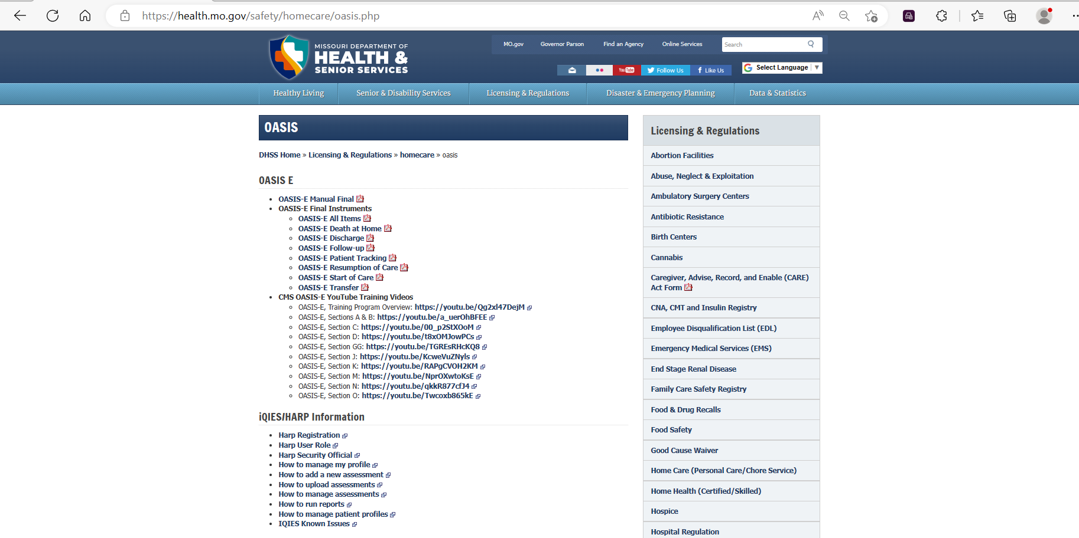
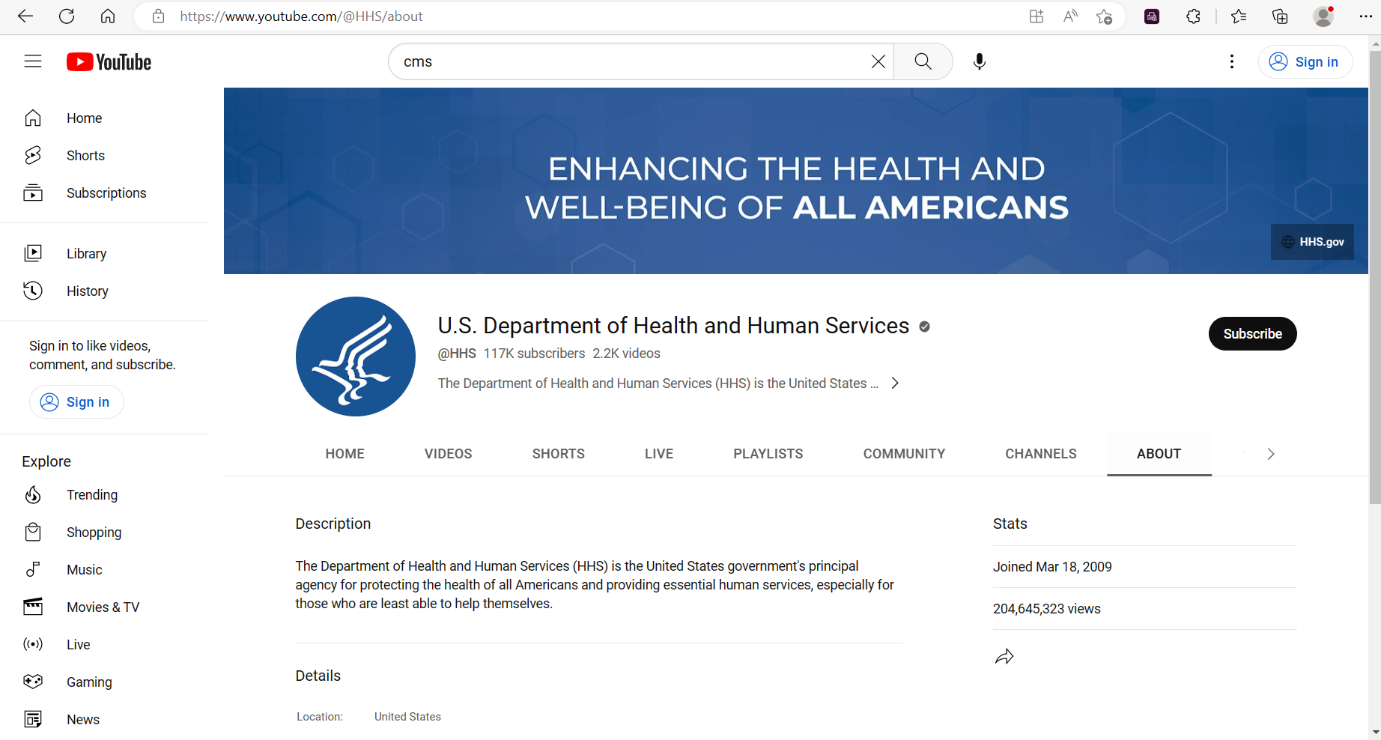
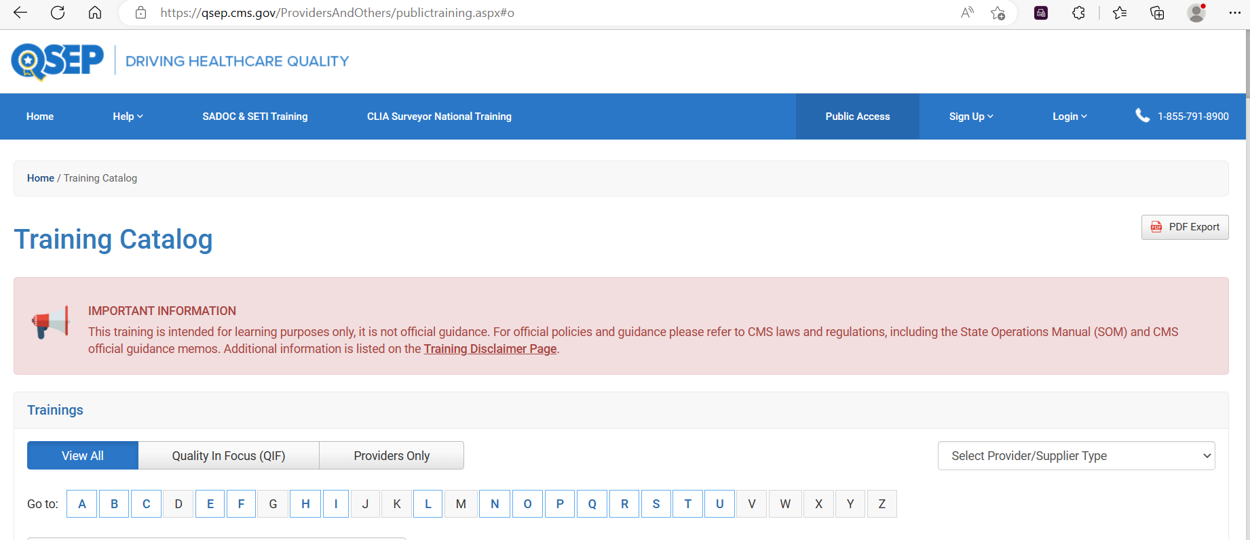
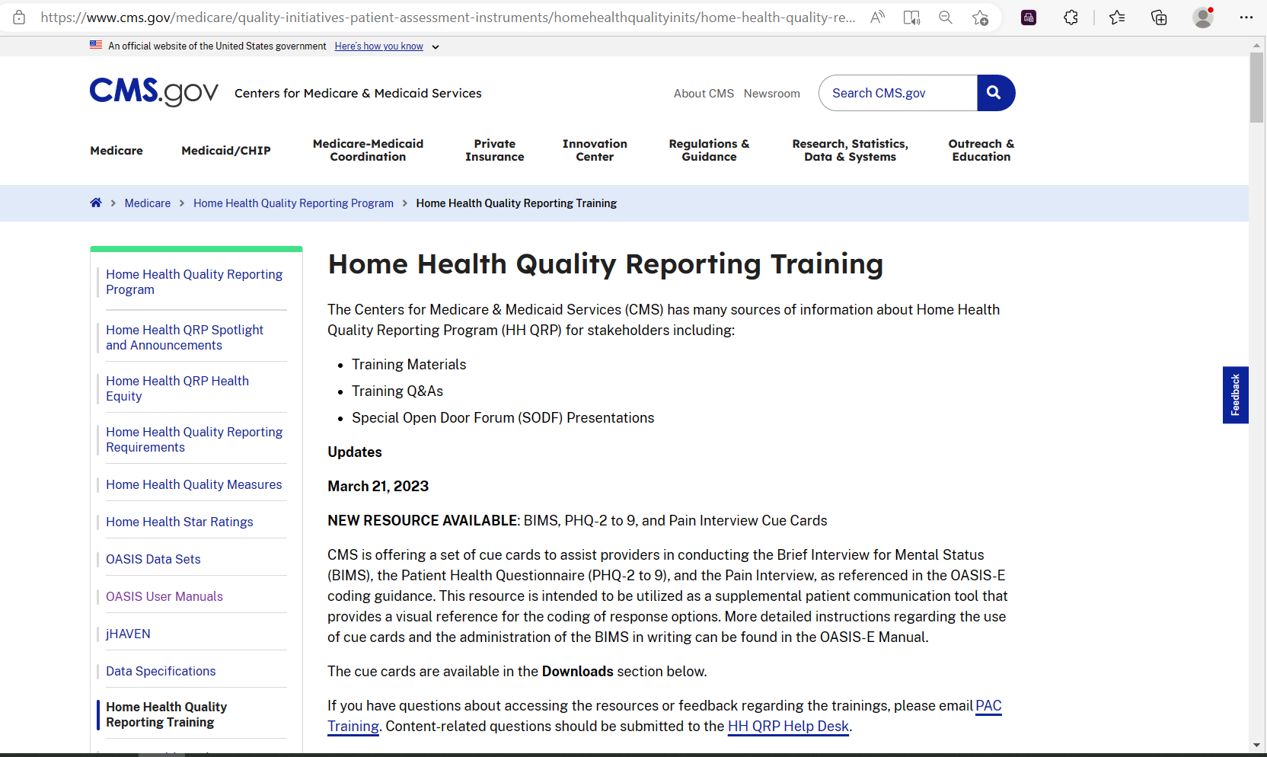
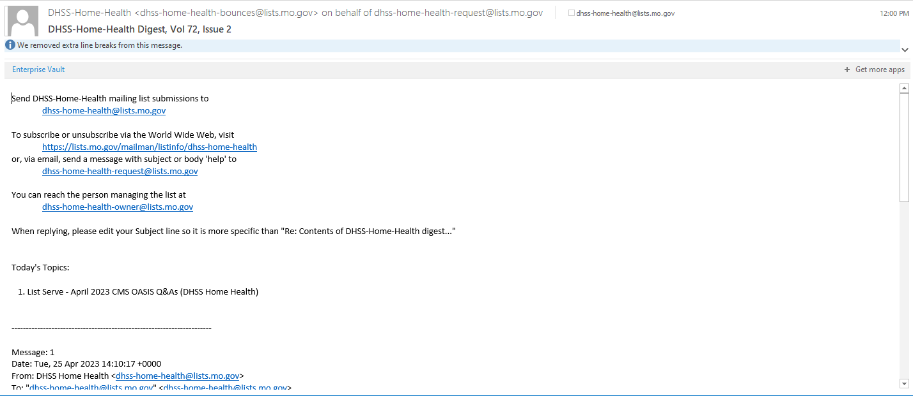
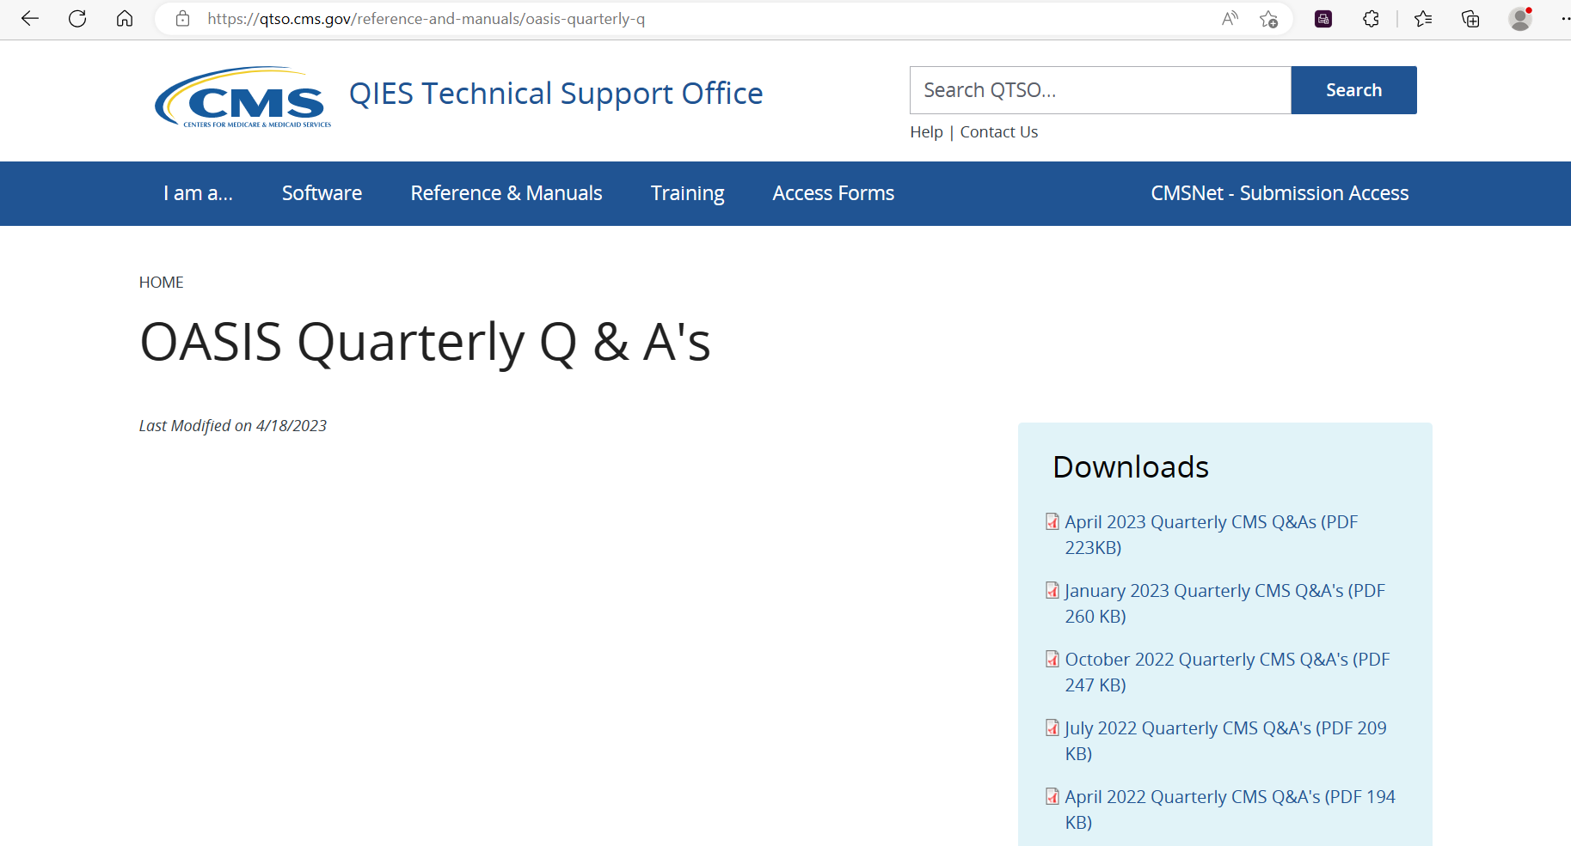
OASIS Education Coordinator
Responsible for ensuring that all home health agencies in the State have access to:
Training in the OASIS data set administration for assessing patients
Training and technical support in integrating the OASIS items in the agency’s record keeping system
This looks like:
Oasis | Home Care | Health & Senior Services (mo.gov)
Training Program Overview – YouTube
DHSS/DRL/BHCRS Listserv
Home Health Quality Reporting Training | CMS
OASIS Quarterly Q & A's | QIES Technical Support Office (cms.gov)
oasisinformation@health.mo.gov
QSEP - Driving Healthcare Quality (cms.gov)

Slide 5
OASIS Automation Coordinator
Responsible for ensuring that all home health agencies in the State have access to:
Facilitating the initial transmission of test data for new HHAs
Providing ongoing technical assistance to HHA providers on the transmission of OASIS data
This looks like:
Oasis | Home Care | Health & Senior Services (mo.gov)
DHSS/DRL/BHCRS Listserv
oasisinformation@health.mo.gov

Slide 6
Additional Resources
For OASIS data reporting questions not related to the Conditions of Participation, please contact the Home Health Quality Help Desk Mailbox: homehealthqualityquestions@cms.hhs.gov.
For OASIS questions related to the Conditions of Participation please contact the Home Health Agency Survey Protocols Help Desk Mailbox: hhasurveyprotocols@cms.hhs.gov.

Slide 7
Missouri OASIS Statistics Overview
Topic | 2022 | 2023
Total Assessments | 297,819 | 84,985 (Projected 297,548)
Total Assessment – Any Error | 40,042 | 16,881 (Projected 32,448)
Total Error Percentage | 13.4% | 19.9%

Slide 8
Missouri Top Ten Error Codes
ID | Topic | 2022 | ID | Topic | 2023
-3330 | Late Submission | 5.00% | -3330 | Late Submission | 5.90%
-915 | Patient Information Mismatch | 4.20% | -5360 | Invalid Version Code | 5.70%
-909 | Inconsistent Record Sequence | 2.40% | -915 | Patient Information Mismatch | 4.10%
-907 | Duplicate Assessment | 1.40% | -909 | Inconsistent Record Sequence | 2.60%
-3630 | Inconsistent M0150 Values | 0.70% | -907 | Duplicate Assessment | 1.40%
-3320 | Inconsistent M0100/M0090 Dates | 0.30% | -3630 | Inconsistent M0150 Values | 0.80%
-925 | Record Timing | 0.30% | -3060 | Invalid Value | 0.60%
-3190 | No Match Found | 0.10% | -925 | Record Timing Invalid | 0.30%
-3300 | Inconsistent dates M0100/M0090 | 0.10% | -3320 | Inconsistent Dates | 0.30%
-3160 | Invalid Agency ID | 0.10% | -3620 | M0140_ETHNIC_AI | 0.20%
2019 Late Submission Rate:
5.8 %

Slide 9
CMS Quarterly OASIS Q & A’s
Every quarter (January, April, July, October)
home-health-agency-hha-providers Reference & Manuals | QIES Technical Support Office (cms.gov)
Effective May 2022, all applicable, historic CMS quarterly Q&As are included in the OASIS‐E Guidance manual. The first CMS Q&A not included in the updated guidance manual was July 2022.

Slide 10
CMS OASIS Training Resources
Home Health Quality Reporting Training | CMS
March 21, 2023: BIMS, PHQ-2 to 9, and Pain Interview Cue Cards
March 20, 2023: Video Tutorial: GG0170C Lying to Sitting on Side of Bed
January 11, 2023: Third Edition HH QRP COVID-a9 Public Reporting Tip Sheet
December 7, 2022: PHQ-2 to 9 Cue Card
October 25, 2022: Home Health OASIS-E Guidance Training Program, Post-event Materials
Includes the recorded workshop sessions, PDF versions of the workshop presentations, and a post-event Q & A document
August 12, 2022: Home Health OASIS-E Guidance Training Program
Contacts for CMS training
Technical training Questions: PACTraining@EconometricaInc.com
Content-related OASIS training questions: HomeHealthQualityQuestions@cms.hhs.gov

Slide 11
OASIS and the Survey Process
Conditions of Participation Associated with OASIS
§484.40 Condition of Participation: Release of patient identifiable OASIS Information (G350)
§484.45 Condition of Participation: Reporting OASIS Information (G370)
§484.45(a) Standard: Encoding and transmitting OASIS data (G372)
§484.45(b) Standard: Accuracy of encoded OASIS data (G374)
§484.45(c) Standard: Transmittal of OASIS data (G376)
G378: Transmission format, G380: Successful Transmission, G382: Transmit Electronically
§484.45(d) Standard: Data Format (G386)

Slide 12
Questions?

Slide 13
Thanks for your time!!

