Slide 1
DIABETES BASICS
Notes:
The American Diabetes Association’s Diabetes Care Tasks at School: What Key Personnel Need to Know is a two-part training curriculum that consists of a CD containing PowerPoint modules and a DVD containing corresponding video segments.
This training is based on and should be used in conjunction with “Helping the Student with Diabetes Succeed: A Guide for School Personnel”, a guide developed by the National Diabetes Education Program (NDEP), which is a federally sponsored partnership of the National Institutes of Health (NIH) and the Centers for Disease Control and Prevention and over 200 partner organizations. Training participants should read the NDEP guide prior to this training in order to gain a full understanding of the requirements of appropriate school diabetes care. Participants should have a copy of the guide during this training and for future reference. The guide can be found on the web at http://www.ndep.nih.gov.
Some key points about the overall training:
Overall objective: The overall goal is to optimize both health and learning for students with diabetes by providing diabetes care training to school personnel about how and when to perform routine and emergency diabetes care tasks for students, under the supervision of a school nurse or another qualified health care professional. Completion of training will help prepare school personnel to perform diabetes care tasks, ensuring that health needs are addressed in times and locations when a nurse is not available.
Rationale: The school nurse, when available, is the most appropriate person in the school setting to provide care for a student with diabetes. However, many schools do not have full-time nurses. Even for schools that do, the nurse may not always be available during the school day, during school-sponsored extra-curricular activities or field trips to assist with routine care and emergency care. Trained school personnel must be available to perform and assist the student with diabetes care tasks.
12/2008

Slide 2


Slide 3
What is Diabetes?
In diabetes:
  Body does not make or properly use insulin
Insulin is needed to:
  Move glucose from blood into cells for energy
If insulin isn’t working, high blood glucose results:
  Energy levels are low
  Dehydration
  Complications
Notes:
Diabetes is a chronic disease in which the body does not make or properly
use insulin, a hormone that is needed to convert sugar, starches, and other
food into energy by moving glucose from blood into the cells.
People with diabetes have increased blood glucose (sugar) levels for one or
more of the following three reasons: Either
Little or no insulin is being produced,
Insulin production is insufficient, and/or
The body is resistant to the effects of insulin.
As a result, high levels of glucose build up in the blood, and spill into the
urine and out of the body. The body loses its main source of fuel and cells
are deprived of glucose, a needed source of energy. High blood glucose
levels may result in short and long term complications over time.

Slide 4
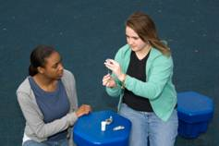
Type 1 Diabetes
  Occurs when the pancreas does not produce insulin
  An autoimmune disorder
  Requires multiple doses of insulin every day – via shots or an insulin pump
  Accounts for 5 to 10% of all cases of diabetes and is the most prevalent type of diabetes among children and adolescents
  Type 1 diabetes
  cannot be prevented.
Notes:
4
TALKING POINTS
Ask the audience if they have a student with type 1 diabetes?
Ask how many have more than one?
Describe type 1 diabetes.
Stress that type 1 diabetes can not be prevented.

Slide 5
Type 2 diabetes
  Occurs when the pancreas does not produce enough insulin or use insulin properly
  Increased type 2 diagnoses among children and adolescents in the U.S.
  African Americans and Hispanic/Latino Americans are at higher risk
  Managed with insulin shots, oral medication, diet and other healthy living choices
  Type 2 diabetes may be prevented.
Notes:
5
TALKING POINTS
What used to be thought of as an “old person” disease is now a problem for youths. Adults and children have type 2 diabetes.
Incorporate any local prevalence data of type 1 and/or type 2 data at this point.
Describe how this is a very different type of disease from type 1. When diagnosed early, people can often manage diabetes with lifestyle changes such as improved nutrition choices and portion sizes, as well as physical activity. This disease can often be delayed or prevented. Type 1 can’t be prevented and has nothing to do with lifestyle choices.

Slide 6

Possible long-term complications
  Heart disease
  Stroke
  Kidney disease
  Blindness
  Nerve disease
  Amputations
  Impotence
  These chronic complications may occur
  over time, especially if blood sugar levels
  are not controlled.
Notes:
6
TALKING POINTS
Accurate and early diagnosis of diabetes is imperative.
Complications can occur at any time and can be deadly in both type 1 and type 2 diabetes.
As school personnel, you are part of a team – led by the school nurse – to care for children with diabetes. Your prompt response to symptoms can play a major role in the prevention of short– and long–term complications. You will also help to ensure that your students with diabetes can maximize learning and academic performance.

Slide 7

Type 1 Diabetes is Managed,
But it Does Not Go Away.
GOAL:
Maintain target
blood glucose
Notes:
Diabetes is managed with medication, nutrition, physical activity and glucose monitoring, but there is NO cure.
When the body doesn’t produce insulin, it must be obtained from another source. All people with type 1 diabetes must take insulin by injection to live.
Many people with type 2 diabetes take glucose-lowering medications which can be taken orally or by injection. Many youth with type 2 take insulin, often in addition to other glucose lowering medications. People with both types of diabetes also need to manage their diet and physical activity.
Neither insulin nor other medications, however, are cures for diabetes: they only help control the disease.
With both type 1 or type 2 diabetes, the goal of effective diabetes management is to control blood glucose levels by keeping them within a target range that is individually determined for each child.
Optimal blood glucose control is essential to:
Promote normal growth and development and allow for optimal learning.
Prevent the immediate dangers of blood glucose that is either too high or too low.
Additionally, research has shown that maintaining blood glucose levels within the target range can:
Prevent or delay the long-term complications of diabetes such as heart attack, stroke, blindness, kidney failure, nerve disease, and amputations of the foot or leg.*
*While it is important for school personnel to be aware of the potential for these serious life-limiting or life threatening complications, it is not appropriate for school personnel to discuss risks for complications with individual students.

Slide 8
Diabetes Management
Constant Juggling - 24/7
Insulin/
medication
with:
        Physical
        activity
BG
BG
and
Food
intake
BG
Notes:
Maintaining good blood glucose control is a juggling act, 24 hours a day, 7 days a week.
The key to optimal diabetes control is a careful balance or juggling of food, physical activity, and insulin and/or oral medication.
As a general rule:
Insulin/oral medication and physical activity makes blood glucose levels go down.
Food makes blood glucose levels go up.
Several other factors, such as stress, illness or injury, also can affect blood glucose levels.

Slide 9
Diabetes Management
Routine Care:
  Many students will be able to handle all or almost all routine diabetes care by themselves
  Some students will need school staff to perform or assist with routine diabetes care
Emergency Care:
  ALL students with diabetes will need help in the event of an emergency situation
Notes:
The need for performance of or assistance with diabetes care tasks will vary from student to student.
Routine Care:
Many students will be able to handle all or almost all of their routine diabetes care by themselves – they can check their own blood glucose, and they can dose and give their own insulin or medication, keeping it in balance with physical activity and food intake.
Some students, because of age, developmental level, or inexperience, will need help from school staff, including performing tasks like insulin administration, blood glucose monitoring, or carbohydrate counting.
Emergency Care:
ALL students with diabetes will need help in the event of an emergency situation.
The level of care and assistance will be outlined in the Diabetes Medical Management Plan (DMMP) agreed upon by the health care provider, parent/guardian, school nurse and student.

Slide 10
Diabetes Medical Management Plan (DMMP)
Basis for all school-based diabetes care plans
Developed by student’s personal health care team and parent/guardian
Signed by a member of student’s personal health care team
Individualized
Implemented collaboratively by the school diabetes team:
      School nurse
      Student
      Parent/guardian
      Other school personnel
Notes:
The Diabetes Medical Management Plan (DMMP) is the foundation for the development of any and all school-based care plans. The DMMP is the medical basis for an Individual Health Care Plan (IHP) written by the school nurse, a Section 504 Plan or Individualized Education Program (IEP), as well as a Quick Reference Emergency Plan.
A DMMP should be implemented for every student with diabetes. (This type of plan may have a different name in some school districts, or by some health care providers.)
The DMMP is developed and signed by the student’s personal health care team and parent/guardian with the specific needs of an individual student in mind. It should detail all the elements of care and assistance for that student.
Once the DMMP has been provided to the school, it is implemented collaboratively by the school diabetes team, which includes the school nurse, student, parent/guardian, and other school personnel.
Details regarding how, when, where and by whom the elements of the DMMP will be implemented should be documented in writing. Many school districts have their own individual health plan forms where the school nurse documents information on diabetes care.
Additionally both health and academic accommodations related to diabetes should be included in broader education plans for students with disabilities.
For example, under Section 504 of the Rehabilitation Act of 1973, a federal law, students with diabetes are entitled to reasonable accommodations to ensure equal access to public education. A 504 plan should be written to document diabetes-related accommodations needed by an individual student.
Some students with diabetes will also be eligible for special education. For these students, diabetes care needs should be documented in the Individualized Education Program (IEP) that is required by another federal law, the Individuals with Disabilities Education Act (IDEA).
Information and a sample DMMP and 504 plan can be found on the American Diabetes Association Website at: http://www.diabetes.org/safeatschool.

Slide 11
HYPOGLYCEMIA
Notes:
12/2008

Slide 12
HYPOglycemia = LOW Glucose (sugar)
  sudden, must be treated immediately with food
  not always preventable
  may progress to unconsciousness if not treated
  can result in brain damage or death
HYPERglycemia = HIGH Glucose (sugar)
  gradual, can be treated with insulin, extra fluids, extra bathroom breaks
  May cause nausea, vomiting, increased thirst
  can result in long-term complications over time
Notes:
Hypoglycemia = low blood glucose level. Hypoglycemia is a low level of glucose in the blood.
Onset: Sudden, usually mild, but will progress if not treated.
May even progress to symptoms of unconsciousness and seizures and if not treated,
can lead to brain damage or death.
The Diabetes Medical Management Plan (DMMP), should specify signs and action steps for each student at each level of severity of hypoglycemia:
Mild
Moderate
Severe

Slide 13
Causes of Hypoglycemia (low blood sugar):
  Administering too much insulin
  Skipping or delaying meals/snacks
  Exercising longer or harder than planned
  More likely to occur before lunch, at end of school day or during/after PE
  Combination of the above factors
Never leave a student alone or send them away when experiencing hypoglycemia. Treat on the spot.
Notes:
13
TALKING POINTS
Hypoglycemia or low blood sugar is one of the most frequent complications of diabetes and can happen very suddenly.
It occurs when a student’s blood sugar level falls too low usually due to administering too much insulin, skipping or delaying meals or snacks, not eating enough food or exercising longer or harder than anticipated. For some students, it is more likely to occur before lunch, at the end of the school day, or during or after physical education class.
Never leave a student alone if he or she is experiencing hypoglycemia. Treat or seek help immediately.

Slide 15
Hypoglycemia: Possible Signs & Symptoms
Mild Symptoms
Hunger | Sleepiness
Shakiness | Changed behavior
Weakness | Sweating
Paleness | Anxiety
Blurry vision | Dilated pupils
Increase heart rate or palpitations
Moderate to Severe Symptoms
Yawning | Confusion
Irritability/frustration | Restlessness
Extreme tiredness/fatigue | Dazed appearance
Inability to swallow | Unconsciousness/coma
Sudden crying | Seizures
Notes:
The symptoms of hypoglycemia vary from one individual to another. Also, they may vary for one individual, from one episode to another.
The symptoms of mild hypoglycemia are the first alert that the body is in a state of sugar deficiency. Symptoms may include the following:
Extreme hunger ▪ Shakiness
Tremors ▪ Dizziness
Lethargic ▪ Headache
Increased heart rate/palpitations ▪ Dilated pupils
Pallor ▪ Clammy skin
Sweating ▪ Anxiety
Changed personality
Mild hypoglycemia can usually be treated easily and effectively. Most episodes of hypoglycemia that will occur in the school setting are of the “mild” type.
However, if not treated promptly a mild hypoglycemic reaction can quickly progress to a severe state or condition which may be characterized by:
Yawning ▪ Irritability/frustration
Behavior/personality changes ▪ Extreme tiredness/fatigue
Sudden crying ▪ Restlessness
Confusion ▪ Inability to swallow
Dazed Appearance ▪ Seizures, convulsions
Unconsciousness/coma
jerking movements
Remember, onset and progression can happen very quickly. Each student will have his/her own set of symptoms that characterize hypoglycemia. These should be listed in the DMMP.
The important thing to remember is that early recognition and intervention is the best strategy to prevent progression to more severe symptoms.

Slide 16
Symptoms of mild hypoglycemia:
  Sudden change in behavior (lethargic, confused, uncoordinated, irritable, nervous)
  Sudden change in appearance (shaky, sweaty, pale or sleepy)
  Complaints of headache or weakness
Response:
1. Give the student a quick-acting sugar equivalent to 15 grams of carbohydrate:
  Examples: 4 oz. of juice, ½ a can of regular soda, or 3-4 glucose tablets
  Ask parents to provide you with
  what works best for their child
Check blood glucose (BG) level 10 to 15 minutes later
Repeat treatment if BG is below student’s target range
Notes:
16
TALKING POINTS
Hypoglycemia – which sometimes cannot be prevented – is the greatest immediate danger to students with diabetes. Hypoglycemia can impair cognition and sometimes can be mistaken for misbehavior. If a student has a sudden change in behavior, becomes lethargic, combative, or unconscious, or is having a seizure or convulsion, presume the student has hypoglycemia and treat the situation as a hypoglycemic emergency.
Can you identify your student’s symptoms of low blood sugar? What are his or her symptoms? How should you react?
Never leave a student alone if he or she is experiencing hypoglycemia. Treat or seek help immediately.
Provide personal example, if possible.
It is important to treat hypoglycemic immediately and on the spot – wherever your student happens to be whether it be in the classroom, playground, an assembly, field trip or the gym. Do not delay treatment. If in doubt, treat as hypoglycemia. Recheck his or her blood sugar level 10 to 15 minutes after treatment to ensure that blood sugar levels are on the rise.
Parents will usually provide you with a “low box” containing their child’s preferred quick acting sugar product. Be sure to keep this quick-acting sugar with you whenever your class and the child are out of the classroom. Before you run out of the supply, alert the parents to send more.

Slide 17
Quick Acting Glucose for Mild/Moderate Hypoglycemia
Treatment for Lows: 15 g Carbohydrate
  4 oz. fruit juice
  15 g. glucose tablets (3-4 tablets)
  1 tube of glucose gel
  4-6 small hard candies
  1-2 tablespoons of honey
  6 oz. regular (not diet) soda (about half a can)
  3 tsp. table sugar
  One-half tube of cake mate
Notes:
Any quick-acting glucose can be used to treat hypoglycemia.
Limit intake to 15 grams (or other amount as specified in the plan) or the student will experience a high blood glucose later. The goal is to bring the blood glucose back to the target range.
Remember: Treatment may need to be repeated at about 15 minute intervals (based on continued low test results or poor symptom response.) Each treatment dose should be 15g unless otherwise stated in the student’s DMMP
Some quick-acting forms of glucose include:
4 oz. fruit juice
3 or 4 glucose tablets
1 tube of glucose gel
4-6 small hard candies
1-2 tablespoons of honey
6 oz. regular (not diet) soda (about half a can)
3 teaspoons of table sugar (dissolved in water)
One small tube of cake mate gel
Younger or very small students might be directed to take 8g of carbohydrate, or about half of the amounts listed on the slide.

Slide 18
Symptoms of severe hypoglycemia:
  Inability to swallow
  Seizure or convulsion
  Unconsciousness
This is the most immediate danger with diabetes.
Response:
  Position student on side
  Contact school nurse or trained diabetes staff
  Administer prescribed glucagon
  Call 911
  Call student’s parents
GLUCAGON IS A HORMONE THAT RAISES BLOOD GLUCOSE LEVELS.
It is only administered when hypoglycemic symptoms are SEVERE.
Glucagon may cause nausea or vomiting, but...
GLUCAGON IS A LIFE-SAVING TREATMENT THAT
CANNOT HARM A STUDENT!
Notes:
18
TALKING POINTS
Severe hypoglycemia is rare at school and generally can be prevented with prompt treatment when the early signs of low blood sugar are recognized. It is important that you know your student’s low blood sugar symptoms so severe low blood sugar can be avoided.
What are some of the symptoms of severe hypoglycemia? Can you identify these in your student? Do you know who in your school has been trained to administer glucagon? It is important that you know how to reach this person in the event your student experiences severe hypoglycemia.
Glucagon is a hormone that raises blood glucose levels by causing the release of glycogen from the liver.
It cannot harm your student.
If student becomes unconscious or experiences convulsions or seizure, position them on their side to prevent choking. Your student may feel sick to his or her stomach or vomit when he or she wakes up.
Your student’s parent or guardian should supply the school with a glucagon emergency kit. When a student is experiencing severe hypoglycemia, the school nurse or other trained person must respond immediately. Your school nurse and other trained personnel should know where the kit is kept and have ready access at all times. If you are not glucagon trained, then contact your school nurse or other trained person who will administer glucagon.
While glucagon is being administered, another school staff member should be calling 911 and the student’s parents.
Consider becoming glucagon trained.

Slide 19
HYPERGLYCEMIA
Notes:
12/2008

Slide 20
HYPERglycemia = HIGH Glucose (Sugar)
Onset:
  Usually slow to develop to severe levels
  More rapid with pump failure/malfunction, illness, infection
  Can mimic flu-like symptoms
  Greatest danger: may lead to diabetic ketoacidosis (DKA) if not treated
DMMP will specify signs and action steps at each level of severity:
      Mild
      Moderate
      Severe
Notes:
Hyperglycemia is a term that refers to high blood glucose level in the blood.
Yet the irony is that with all the glucose floating around in the blood the body cells are actually starving because glucose cannot get in.
An isolated high blood glucose reading is cause for concern, but not alarm. For example, blood glucose is expected to be somewhat higher following a meal or snack, but it should also drop once insulin starts to work. However, it is also important to note that hyperglycemia can occur more rapidly in students with insulin pumps if a pump malfunctions or delivers less insulin. Illness or infection can also contribute to a more rapid escalation of hyperglycemia. Hyperglycemia becomes an increasing concern when several consecutive readings have been high, or when accompanied by vomiting.
As hyperglycemia progresses, the student may be nauseous or be dehydrated and listless – often it looks flu-like. Any student with diabetes who presents with flu-like symptoms should immediately perform a blood glucose check, contact the school nurse and/or parent/guardian as directed by the student’s DMMP.
Hyperglycemia most often does not appear to be as dramatic as does low blood glucose – so it is perceived as less threatening. Yet untreated, high blood glucose presents a much greater threat, especially for those students who are dependent on insulin.
If there is not enough insulin for any reason - pump malfunction, failure to take insulin or insulin not working effectively - there maybe a breakdown in fat, causing ketones to form, ketones may build up in the blood and may result in diabetic ketoacidosis (DKA). Fortunately, the onset of hyperglycemia and progression to DKA is usually pretty slow.
The student’s DMMP should determine precisely what actions should be taken at each level of severity of hyperglycemia.

Slide 21
Hyperglycemia: Possible Signs & Symptoms
Severe Symptoms
Labored breathing | Confusion
Profound weakness | Unconscious
Moderate Symptoms
Dry mouth | Vomiting
Stomach cramps | Nausea
Mild Symptoms
Lack of concentration | Thirst
Frequent urination | Flushing of skin
Sweet, fruity breath | Blurred vision
Weight loss | Increased hunger
Stomach pains | Fatigue/sleepiness
Notes:
The onset of severe hyperglycemia and progression to DKA is usually pretty slow. As a result, the recognition and treatment of mild hyperglycemia is vitally important.
These symptoms vary somewhat from individual to individual, or from episode to episode and can include:
Thirst Blurred vision
Lack of concentration Weight loss
Frequent urination Sweet, fruity breath
Fatigue/sleepiness Stomach pains
Increased hunger Flushing of skin
The following symptoms indicate that hyperglycemia has escalated.
Mild symptoms plus:
Dry mouth
Nausea
Vomiting
Stomach cramps
Sweet, fruity breath
This last group of symptoms indicate severe hyperglycemia, and probable ketoacidosis.
Mild and moderate symptoms plus:
Labored breathing
Profound weakness
Confusion
Unconscious
The important thing to remember is that intervention at any of these levels will prevent progression to more severe symptoms.

Slide 22
Hyperglycemia: What to do
Goal: lower the blood glucose to target range.
Action steps, following DMMP
Verify with blood glucose check
Check ketones
Allow free use of bathroom and access to water
Administer insulin
Recheck blood glucose
Call parent/guardian
Note any patterns, communicate with school nurse and/or parent/guardian
Notes:
To prevent progression, action needs to be taken at the first signs of hyperglycemia, in accordance with the student’s DMMP.
The goal in the treatment of hyperglycemia is to lower the blood glucose level to within a student’s target range.
Always follow the individual student’s DMMP.
Generally, the action steps for hyperglycemia are:
First of all, verify status with a blood glucose check as specified in the DMMP.
Secondly, check ketones as specified in the DMMP.
Allow free use of bathroom and access to water
Administer insulin as specified in the DMMP.
Recheck blood glucose per DMMP.
The parent/guardian should be notified immediately when the conditions for contact are present as specified in the DMMP.
Note patterns and need for bathroom or water access and communicate with student, school nurse or parent/guardian as specified in DMMP.

Slide 23
BLOOD GLUCOSE MONITORING
Notes:
12/2008

Slide 24
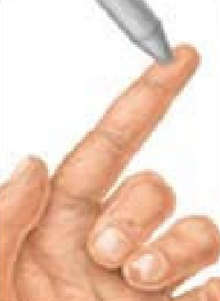
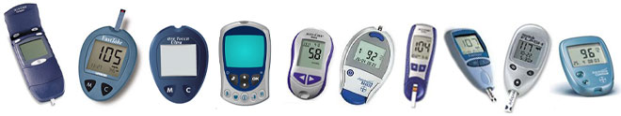

Checking Blood Sugar with a Glucose Meter
Notes:
Instructions:
4. Turn the meter on if necessary. Some meters turn on automatically when the strip is inserted.
5. Check code number that appears on meter with the code number found on the container of the test strips. Correct meter code if codes do not match.
6. Insert a strip into the meter (some meters turn on automatically when the strip is inserted).

Slide 25
Any Time, Any Place Monitoring
For students who can self-check:
Improved blood glucose control
Safer for student
Student gains independence
Less stigma
Less time out of class
Assists decision making in response to result
Notes:
Who/what determines if the student can self check?
A determination regarding individual capacity for self-checking is jointly made by the student, his/her parent/guardian and his/her health care provider – all in collaboration with the school nurse.
What are the advantages of checking blood glucose levels any time and any place?
The student can achieve improved blood glucose control to prevent long-term complications of high blood glucose and complications of acute low blood glucose levels.
It is safer for student because less time is lost between recognizing symptoms, confirming low blood glucose, and obtaining treatment with a fast-acting sugar source followed by a snack or meal.
The student gains independence in diabetes management when the blood glucose meter is easily accessible and checks can be conducted as needed.
The student experiences less stigma as blood glucose monitoring loses its mystery when handled as a regular occurrence.
Students with diabetes who check their blood glucose levels in the classroom spend less time out of class.
Self-checking blood glucose levels helps students to learn and understand decision making process in taking the appropriate response to a blood glucose reading result.

Slide 26
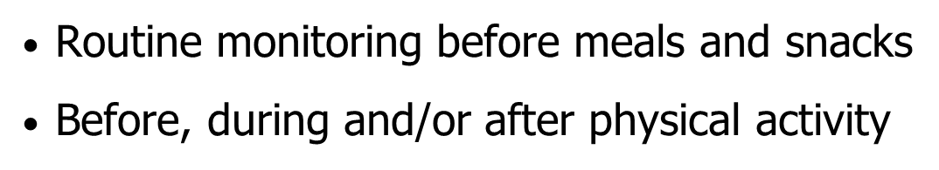
When to Check?
  Also
  Hypoglycemia or hyperglycemia symptoms
  Change in diabetes management
  Periods of stress or illness
  Prior to academic tests
Notes:
There are times when a student needs to check blood glucose more often than usual, including the following
When low or high blood glucose is suspected, either because the student feels symptomatic or the adult observes symptoms.
During periods of stress or illness
Prior to academic tests
When there are changes made in the management program - such as a change in medication doses, meal plan, or physical activity.
Early or delayed release from school (e.g. inclement weather)
When the CGM alarms
The conditions for performing non-routine blood glucose checks should be specified in the DMMP. Generally, the student and/or parent/guardian will determine if/when additional blood glucose checks are required based on specific symptoms or concerns.
Teachers are encouraged to bring concerns about frequency of blood glucose checks to the attention of the school nurse, student, parent/guardian, and/or health care providers as appropriate.

Slide 27
Continuous Glucose Monitoring (CGM)
How it works:
  A tiny glucose-sensing device called a "sensor" is inserted just under the skin
  The sensor measures glucose in the tissue and sends the information to a small device
  The system automatically records an average glucose value every 5 minutes for up to 3, 5, or 7 days
  Finger stick pokes and regular meter needed to calibrate
  Alarms signal when glucose is out of target range
Notes:
In the past few years considerable progress has been made in the continuous monitoring of glucose levels. The steps on the screen explain the basics of how the continuous monitoring technology works:
A tiny glucose-measuring device called a "sensor" is inserted just under the skin.
The sensor measures glucose in the tissue fluids several times a minute and sends the information to a pager-sized device.
The system automatically displays and records an average glucose value every five minutes for up to 3, 5, or 7 days depending on manufacturer.
The state of the continuous monitoring technology is such that finger stick pokes are still required to effectively calibrate the device.
Alarms signal when glucose is out of target range.
While continuous glucose monitors are becoming more common, they are still not widely used. Some individuals use them for a short period to give the health care providers a picture of what is happening with glucose levels between monitoring times, particularly after meals and at night while sleeping.
A student who wears a continuous glucose monitor to school still needs to check blood glucose with a regular meter before treatment.

Slide 28
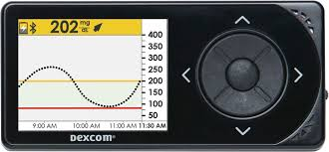

Slide 30
INSULIN BY SYRINGE
AND VIAL or PEN
Notes:
12/2008

Slide 31
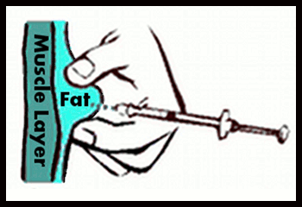
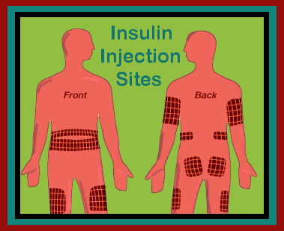
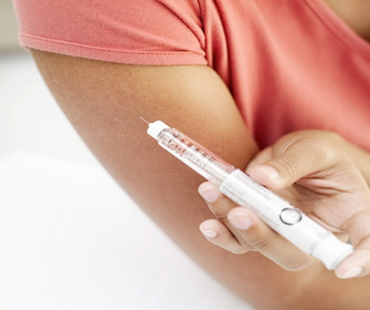
On Target!
Common sites: abdomen, thigh buttocks, upper arms
Notes:
Insulin works best when it is injected into a layer of fat under the skin, above the muscle tissue
Rotating sites is important to insulin absorption
Common preferred sites are the abdomen, thighs, buttocks, and upper arms
Student should help choose injection site

Slide 32
INSULIN BY PUMP
Notes:
12/2008

Slide 33
What Is an Insulin Pump?
Battery operated device
Reservoir filled with insulin
Computer chip with user control of insulin delivery
Worn 24 hours per day
Delivers only rapid-acting insulin
Notes:
An insulin pump is an external, battery-powered device that continuously delivers insulin in small doses to the body.
Most pumps, like the one on the left in the blue bordered frame, look very much like a pager and can be attached to a belt or waistband, carried in a pocket, or held with a strap around the arm or thigh. The pump contains a cartridge or reservoir of insulin.
These pumps deliver insulin through a tube, as shown in the large picture on the screen. The pump connects to narrow, flexible plastic tubing that ends with a short plastic catheter inserted just under the skin in the abdomen, buttocks, or thigh. Users set the pump to give a steady trickle or "basal" amount of insulin continuously throughout the day. Pumps release "bolus" doses of insulin (several units at a time) at meals and at times when blood glucose is too high based on the user’s programming.
Some pumps , like the one in the lower right in the red bordered frame, are attached directly to the body. This newer kind of insulin infusion pump is often referred to as a patch pump or “pod”. This type differs in that it adheres directly to the skin, without using additional tubing. It is a disposable unit that is controlled by a separate PDM device. In the pod-type pumps, insulin jet injectors send a fine spray of insulin through the skin by a high-pressure air mechanism instead of needles.

Slide 34
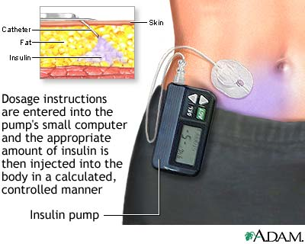
Dosing with an Insulin Pump
Notes:
An insulin pump delivers one type of insulin – no mixing types.
Newer models have a number of calculation and reminder wizards, for example to assist with calculating insulin bolus dosage based on carbohydrate intake and blood glucose level or to remind users about active insulin while dosing.

Slide 36
GLUCAGON ADMINISTRATION
Notes:
12/2008

Slide 37
What Is Glucagon?
Naturally occurring hormone made in the pancreas
A life-saving, injectable hormone, Glucagon/GlucaGen that raises blood glucose level by stimulating the liver to release stored glucose
Treatment for severe hypoglycemia
Life-saving, cannot harm a student – cannot overdose
Notes:
Glucagon is a hormone that occurs naturally in the body. It is produced in the pancreas and raises blood glucose levels by causing the release of glycogen (a form of stored carbohydrate) from the liver that raises blood glucose levels.
Glucagon by injection is a life-saving prescription medication (called GlucaGen by one manufacturer). It is given by injection and used to treat serious hypoglycemia. It was created for use by people who are not health care professionals.
If it is specified in the student’s Diabetes Medical Management Plan (DMMP), glucagon should be used when the student is unconscious, experiencing convulsions, or cannot eat or drink safely. Severe hypoglycemia can cause brain damage or death.
While it may cause nausea and vomiting when the student regains consciousness, glucagon is a life-saving treatment that cannot harm a student. Cannot overdose.

Slide 38
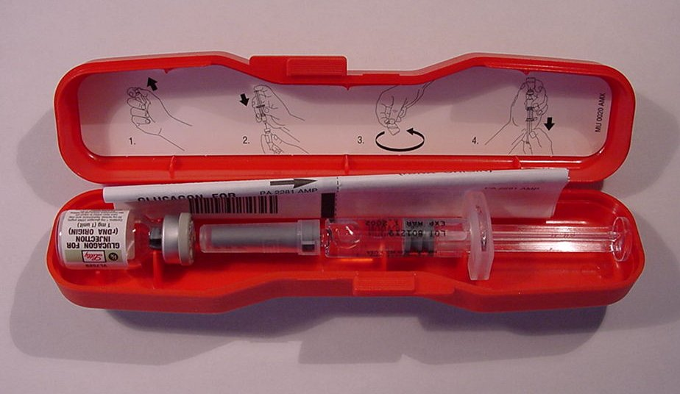
Emergency Kit Contents:
1 mg of freeze-dried glucagon (Vial)
  1 ml of water for reconstitution (Syringe)
Combine immediately before use
Notes:
This photo shows the inside of a glucagon emergency kit. Glucagon must be injected.
Instructions are included in package.
In addition to participating in this training, instructions inside the kit should be reviewed.
Within the glucagon kit are:
a syringe pre-filled with a saline and
a vial of powdered glucagon.
Combine the glucagon for injection immediately before use by following the instructions that are included with the glucagon kit.

Slide 39
When to Give Glucagon/Glucagen
If authorized by the student’s DMMP and if student exhibits:
  Unconsciousness, unresponsiveness
  Convulsions (seizures)
  Inability to safely eat or drink
Notes:
When hypoglycemia is severe, the school nurse or trained diabetes personnel must respond immediately.
Regardless of whether glucagon is to be given or not, emergency personnel should be summoned by calling 911 or emergency response personnel as soon any of the following are exhibited:
Unconsciousness, unresponsive
Convulsions (seizures) or jerking movements
Inability to safely eat or drink
If student is having a seizure, is unconscious, or having difficulty swallowing, do not attempt to give food or a drink or to put anything in his or her mouth because it could cause the student to choke.

Slide 40
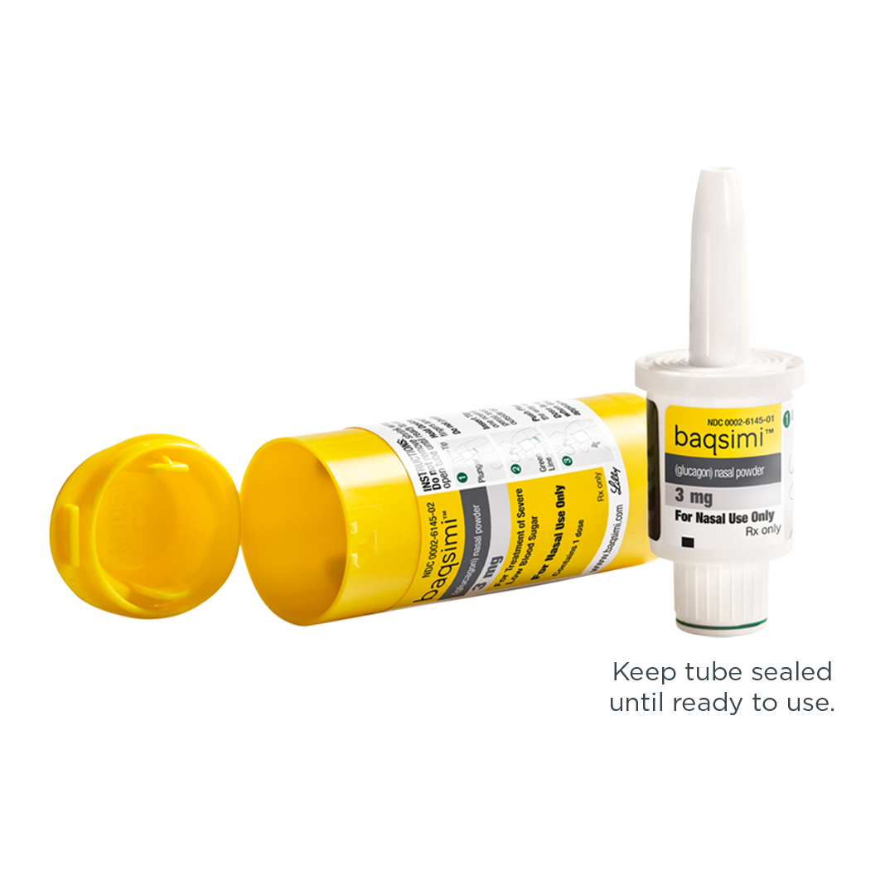
https://www.baqsimi.com/how-to-use-baqsimi

Slide 41
Procedure: Act Immediately
If possible check blood glucose, don’t delay
If in doubt, always treat
Position student safely on side for comfort and protection from injury
School nurse or trained personnel notified to give glucagon in accordance with DMMP or emergency care plan
Call 911, parent/guardian, school nurse as per DMMP or emergency care plan
Notes:
If possible, do a blood glucose check.
Don’t delay if a meter is not available and low blood glucose symptoms are being exhibited. If in doubt, always treat.
Position student safely – Be sure that the student is lying on his or her side in a clear, safe area protected from head and bodily injury.
Do not leave student alone.
School nurse or other trained diabetes personnel should give glucagon as soon as possible after discovering that the student is unconscious or unable to swallow.
A second person should call 911, then parent/guardian and school nurse as per DMMP.

Slide 42
KETONES
Notes:
12/2008

Slide 43
What Are Ketones?
Acids that result when the body does not have enough insulin and uses fats for energy
May occur when insulin is not given, during illness or extreme bodily stress, or with dehydration
Can cause abdominal pain, nausea, and vomiting
Without sufficient insulin ketones continue to build up in the blood and result in diabetic ketoacidosis (DKA)
Notes:
Ketones are acids that result when the body does not have enough insulin and uses fats for energy.
Ketones may be observed when insulin is not given, during illness or extreme bodily stress, or with dehydration.
Ketones can cause abdominal pain, nausea, and vomiting.
Without sufficient insulin ketones continue to build up in the blood and result in diabetic ketoacidosis (DKA).

Slide 44
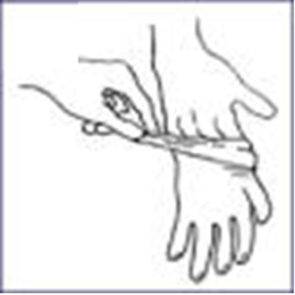
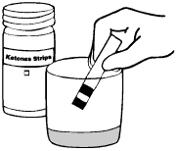
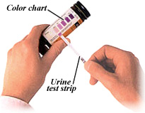
How to Test Urine Ketones
1. Gather supplies
2. Student urinates in clean cup
3. Put on gloves, if performed by someone other
than student
4. Dip the ketone test strip in the cup
containing urine. Shake off excess urine
5. Wait 15 - 60 seconds
6. Read results at designated time
7. Record results, take action per DMMP
Notes:
Urine Ketone Testing Instructions:
1. Gather supplies:
vial of ketone strips,
urine cup
2. Student urinates in clean cup.
3. Put on gloves, if performed by someone other than student.
4. Dip the ketone test strip in the paper cup containing urine. Shake off excess urine.
5. Wait 15 - 60 seconds, as indicated on the directions printed on the bottle label.
6. Read the results at the designated time by comparing the color on the strip to the color chart printed on the label on the bottle.
7. Record results and take action per DMMP.

Slide 45
Treatment of Ketones
DMMP specifies treatment for ketones for the individual student.
free use of bathroom
sugar-free liquids
insulin as per DMMP
limit physical activity
if vomiting or lethargic, call parent/guardian
Generally:
Notes:
If ketones are present, treatment should follow the recommendations specified for the individual student in his/her DMMP, including the notification of parent/guardian and/or student health care providers as appropriate.
Generally:
Allow free use of bathroom.
Students should be encouraged to drink sugar-free, calorie free liquids, like water or diet soda. Students who are nauseous and vomiting may need to take in liquids slowly to avoid more vomiting and dehydration.
Extra insulin may need to be given. The student’s DMMP should specify what dose should be given for the blood glucose and ketone test results.
Students should not engage in physical activity per DMMP.
If vomiting occurs or if student is lethargic with ketones present, parent/guardian should be called or call for medical assistance if parent/guardian cannot be reached.

Slide 46
NUTRITION
Notes:
12/2008

Slide 47
Basic Meal Plans
Key: Balance insulin/medications with carb intake
Most students have flexibility in WHAT to eat
  Basic Carbohydrate Counting
  Advanced Carbohydrate Counting
Many students have flexibility in WHEN to eat
  More precise insulin delivery (pumps, pens)
  Rapid-acting insulins
  Time dosing of insulin according to DMMP
Notes:
The management of type 1 diabetes has changed dramatically in the last 6-7 years, but the basic idea of balancing insulin or medications with carbohydrate intake has remained the same.
More children than ever benefit from the flexibility in meal planning using the exchange or carbohydrate counting methods.
These meal planning approaches are used successfully with traditional insulin plans, multiple daily insulin injections, or insulin pumps.
The increased use of pen-devices and pumps to deliver insulin has made “on-the-spot” insulin delivery easier and more precise.
Additionally, the introduction of newer insulins has cut down on the need to snack just to avoid low blood glucose.
Most students will dose their insulin before a meal or substantial snack. However, some, who are picky or unpredictable eaters, may dose after eating, based on the actual amount of carbohydrate eaten. The timing of insulin dosing with respect to meals and snacks should be specified in the DMMP.

Slide 48
Advanced Carbohydrate Counting
USING THE INSULIN-TO-CARB RATIO
The insulin-to-carb ratio:
  Varies from student to student
  Is determined by the student’s health care team
  Should be included in the DMMP
  Usually stated as a ratio of 1 unit of insulin to x grams carbohydrate
  May vary from meal to meal for a student
Notes:
The most advanced carbohydrate counting method allows the student to adjust his/her insulin depending on the amount of carbohydrate eaten at each meal or snack.
The insulin-to-carb ratio:
Insulin-to-carb ratio can be defined as the amount of rapid or short acting insulin that is needed to “cover” the blood glucose raising effect of a carbohydrates that are consumed at the meal or snack.
Varies from student to student.
Is determined by the student’s health care team
Should be included in the DMMP.
Usually stated as a ratio of 1 unit of insulin to x grams carbohydrate.
The insulin-to carb ratio method is used more often by:
Students who are trying to maintain tight control
Students who use multiple daily injection insulin plan or insulin pumps
Older or more independent students
Students who are picky or unpredictable eaters
Students who use this method may administer insulin before, during, or after the meal per their DMMP.
If students are administering insulin before the meal, it is particularly important that they know the menu and the nutritional value of menu items, whether the lunch is purchased at school or prepared at home.

Slide 49
Final considerations………………..

Slide 50
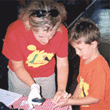
Trained Staff can help by:
  Supporting self-care by capable students
  Learn signs and responses to low blood sugar levels
  Allow blood glucose monitoring and free access to bathrooms/water/nurse office at any time
  Knowing where snacks are stored and can be accessed quickly for a particular student
Notes:
50
TALKING POINTS
Your understanding and support can make all the difference in the health and outlook of your student. Tell personal story of a situation with a family that worked well because of ongoing communication among school staff, parents, the child’s health care team and the student.
Encourage self-care, but don’t draw attention to a student performing a fingerstick blood sugar check.
Make sure diabetes supplies and snacks are accessible to student. Students should carry a quick-acting form of carbohydrate to treat low blood sugar. You may also want to ask parent to give you some glucose tabs or juice boxes to keep at your desk. Make sure students eat snacks on time. Perhaps set a timer if your student needs a gentle reminder.
If a student misses classroom time or an exam, or if his or her cognition is impacted by lows or highs, give extra time to make up missed work, tests, and other assignments.
Do you know if your student has a 504 plan? Do you know what classroom accommodation are required and what you need to do to ensure compliance with his or her 504 and health care plan.

Slide 51

Classroom Tips for teachers:
  Keep contact numbers and names of trained
  diabetes staff at your desk for emergencies
  Create a diabetes info sheet for substitute teachers
  Teach your class about diabetes
  Let parents know, in advance, changes to the class schedule (field trips, special events, etc.)
Notes:
51
TALKING POINTS
Do you know who in your school has been trained to provide diabetes care?
Does your substitute teacher plan identify your student with diabetes and explain his or her classroom needs? Include 3 common signs and symptoms of the child’s low blood sugar. Include 3 common signs and symptoms of the child’s high blood sugar.
Do you know when your student needs to check his or her blood sugar? Can he do it at his desk or does he desire privacy?
Let parents know as soon as possible about class parties or other special events. Children with diabetes can eat the same foods as other children with advanced planning.
Consider developing a lesson plan about diabetes and incorporate it in your science or health lessons. ADA has several lessons available for you at diabetes.org/schoolwalk. School Walk for Diabetes is a great program that will help our students to learn more about diabetes and provide community support for children with diabetes.

Slide 52
Questions?
You will now begin Part 2 of your training, Hands-on Practice

Slide 53

Session wrap up and final questions!

Slide 54
American Diabetes Association
http://www.diabetes.org/
Juvenile Diabetes Research Foundation
http://www.jdrf.org/
“Helping the Student with Diabetes Succeed: A Guide for School Personnel” ,National Diabetes Education Program (NDEP)
“Legal Issues in School Health Services” (Schwab & Gelfman)
School Nursing: A Comprehensive Text (Selekman)
Eagle Book series, Centers for Disease Control and Prevention--CDC http://wwwn.cdc.gov/pubs/diabetes.aspx
NDEP--National Diabetes Education Program http://ndep.nih.gov/hcp-businesses-and-schools/Schools.aspx

Slide 55
American Association of Diabetes Educators (AADE) http://www.aadenet.org/
Missouri Dept. of Health & Senior Services http://health.mo.gov/warehouse/e-literature.html
Local chapter of American Diabetes Association or Juvenile Diabetes Foundation
Lily Pharmaceuticals- free glucagon or Baqsimi trainer
1-800-545-5979
Diabetes camps
County health departments
Diabetes educators from local health agencies
Diabetes support groups
Diabetes/ endocrinology departments of research-based local hospitals

